Slide 1
Kolaboracyjne edytowanie w Gutenbergu
Dawid Urbański

Slide 2
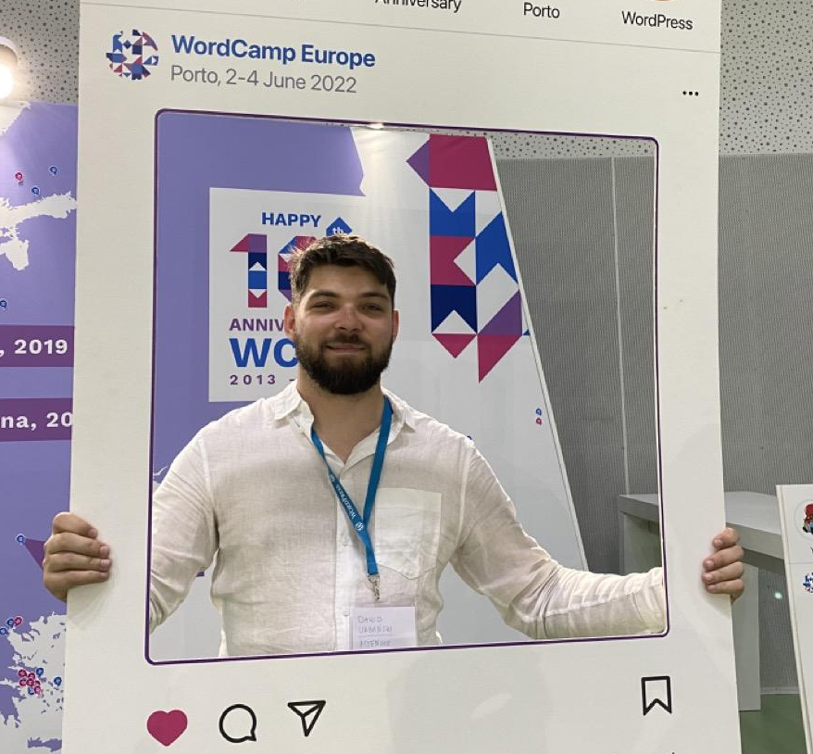
Dawid Urbański
Full-stack web developer, WordPress developer, Tech Lead.
Huge fan of Gutenberg, JavaScript, TypeScript, React and everything web dev related.
#WCEU2023

Slide 3
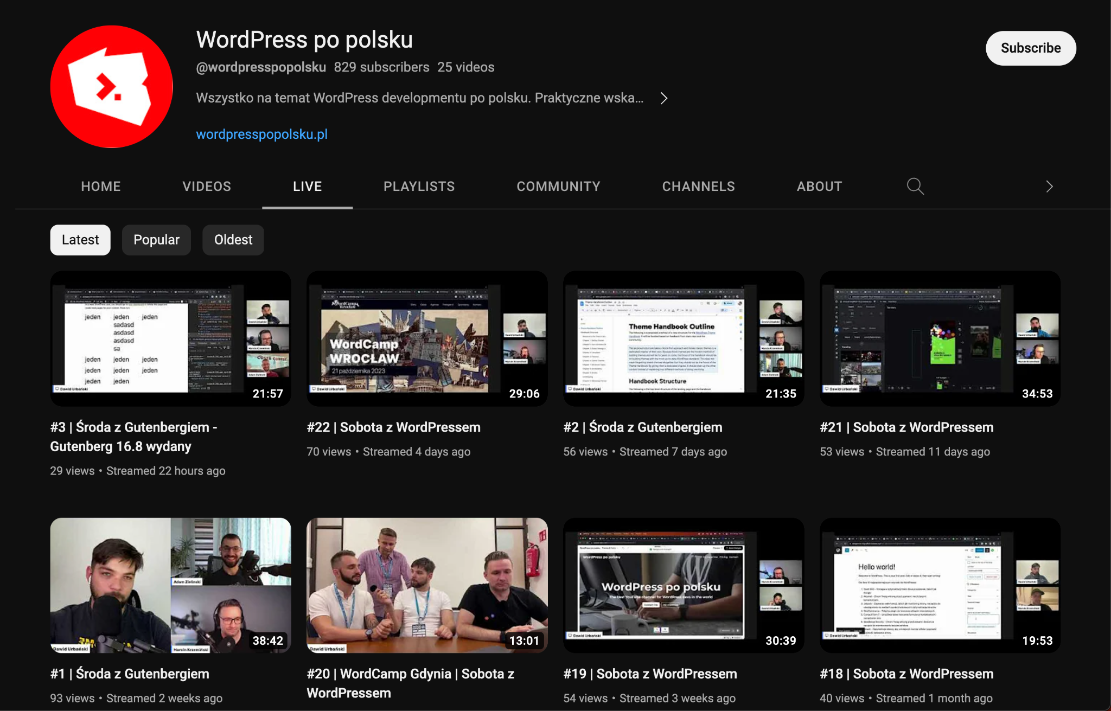

Slide 4
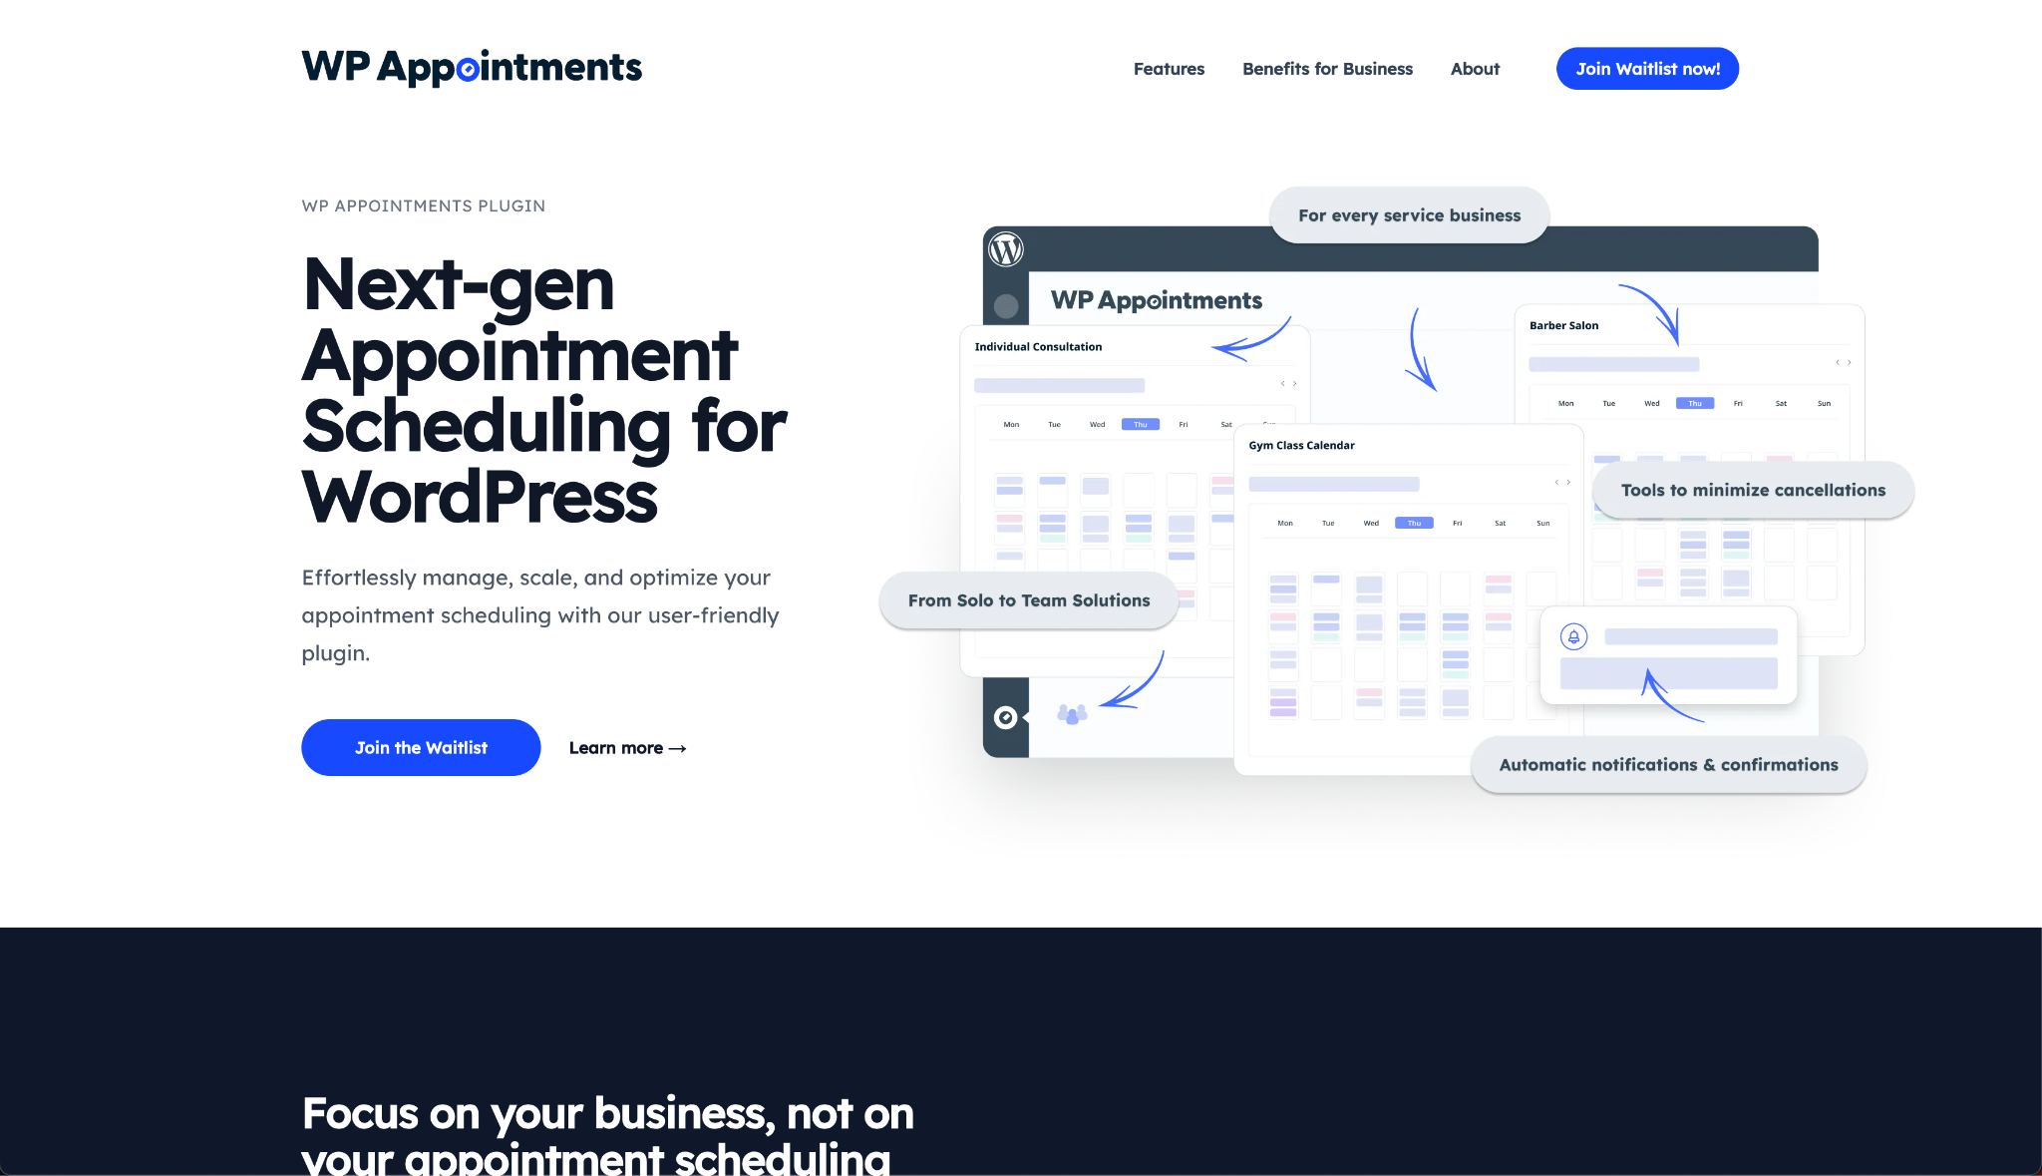
https://wpappointments.com

Slide 5
https://akademiagutenberga.pl

Slide 6
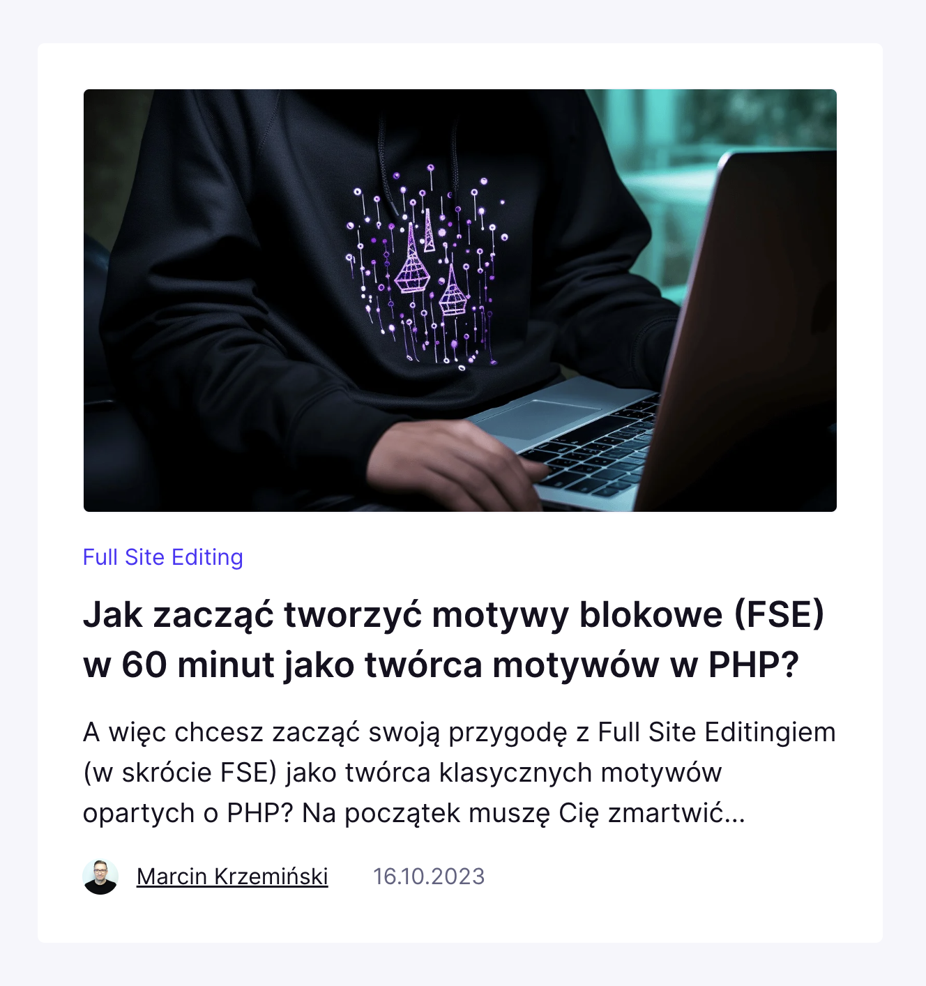
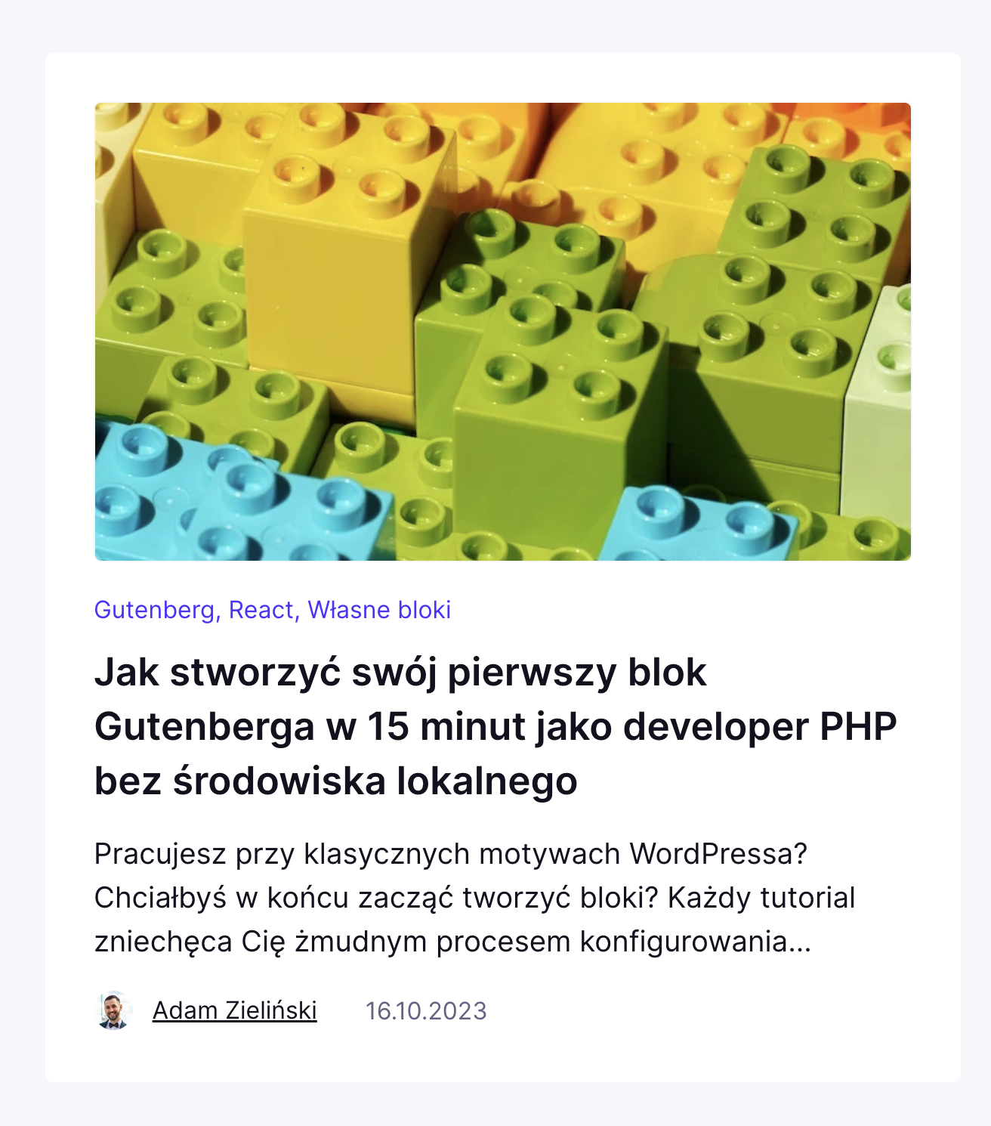
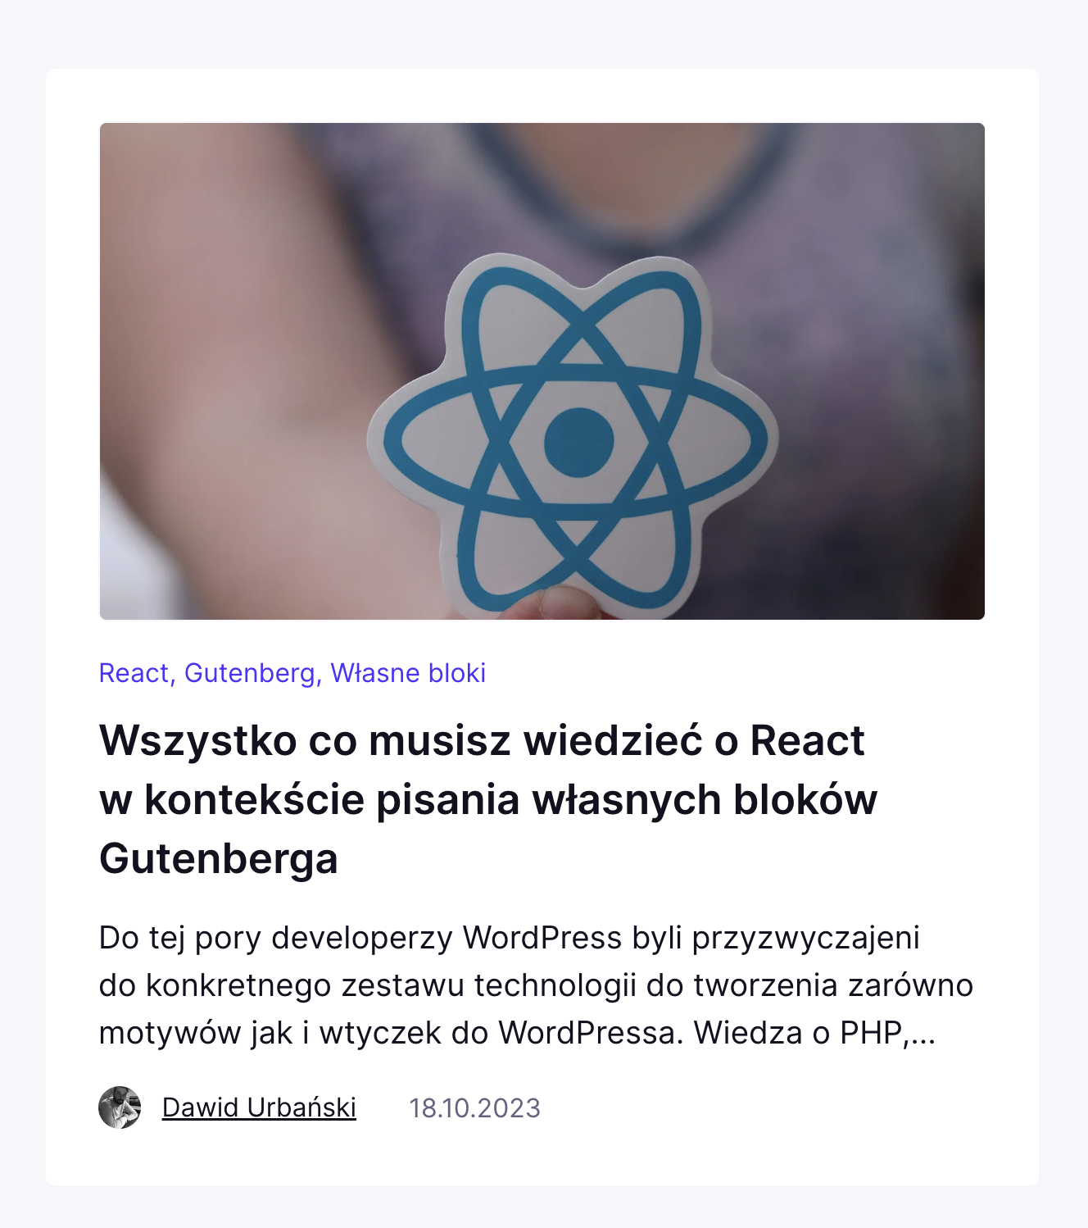
https://akademiagutenberga.pl

Slide 7
Why?
#WCEU2023
Notes:
Why am I talking about it?

Slide 8
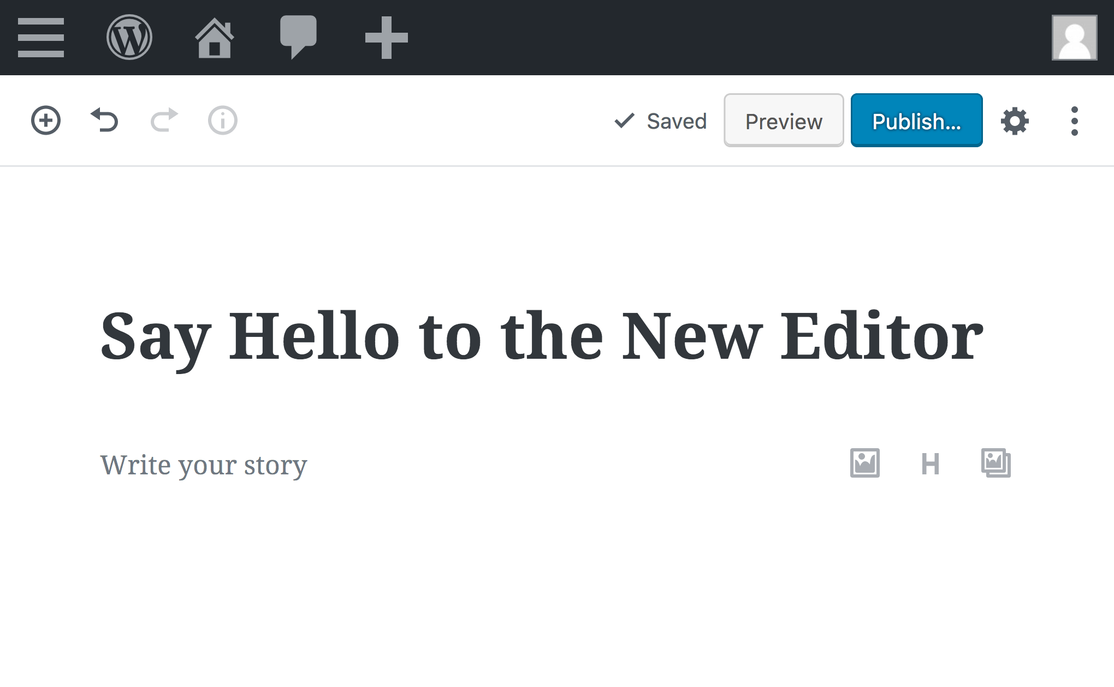
#WCEU2023
Notes:
First of all, as I already mentioned, I love Gutenberg project. I truly believe it’s a future of content editing.

Slide 9
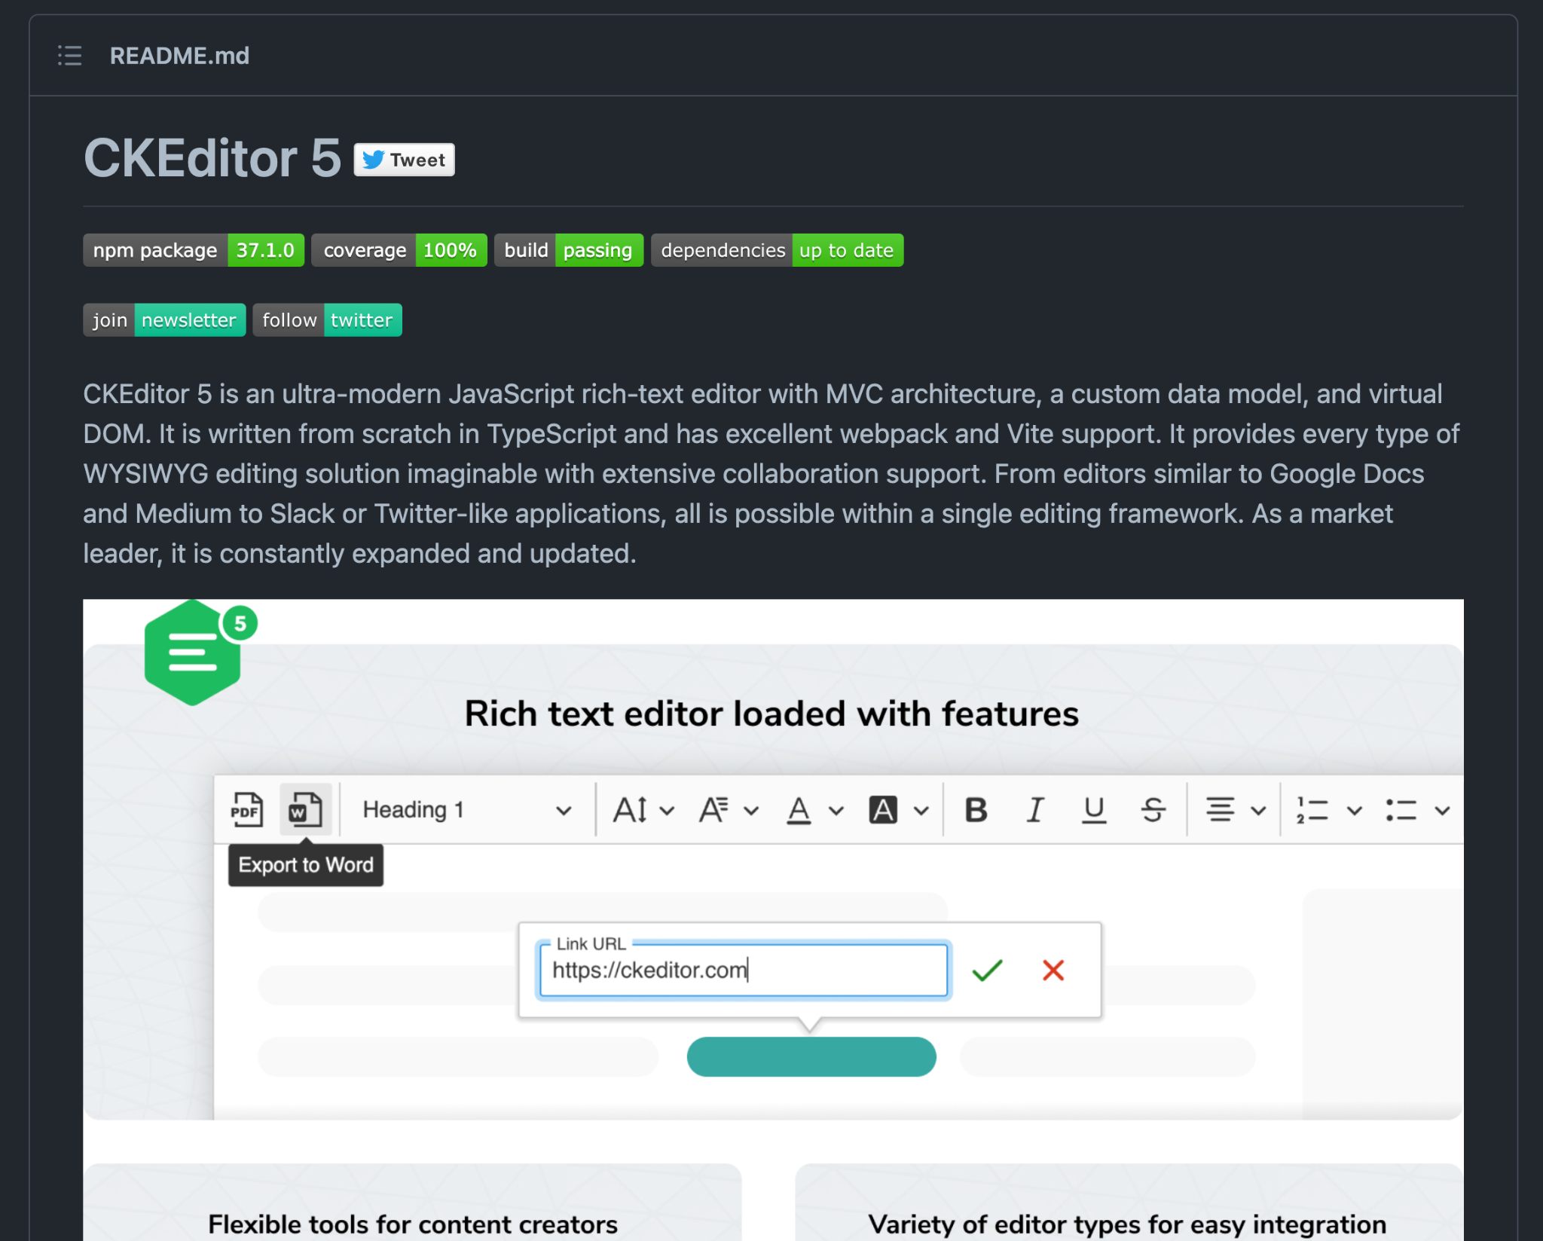
#WCEU2023
Notes:
Second of all, I worked as JavaScript Technical Leader at CKSource building CKEditor5, where I was heavily exposed to collaborative editing.

Slide 10
Long term roadmap
#WCEU2023
Notes:
Let’s also take a look at the long term Gutenberg roadmap

Slide 11
Long term roadmap
Phase 1: Easier Editing
Phase 2: Customization
Phase 3: Collaboration
Phase 4: Multilingual
#WCEU2023
Notes:
Easier editing - already implemented - the editor itself
Customization - in progress: block patterns, block themes, block directory and full site editing
Collaboration - the next phase that we are focusing on in this presentation
Native multilingual content support in WordPress

Slide 12
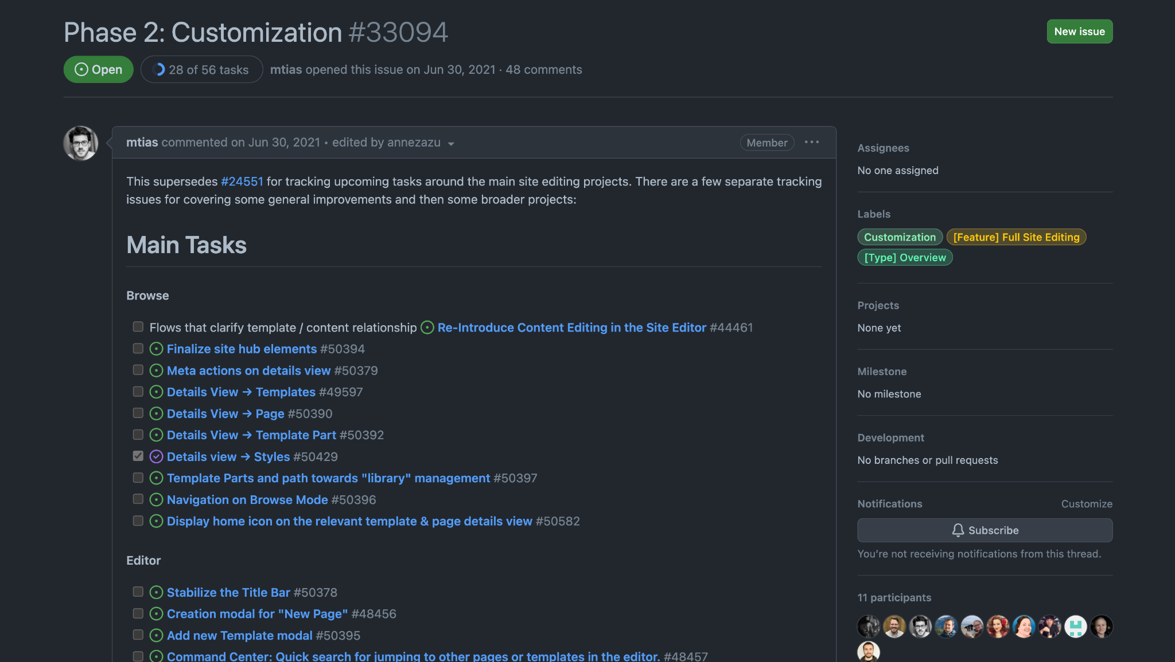

Slide 13
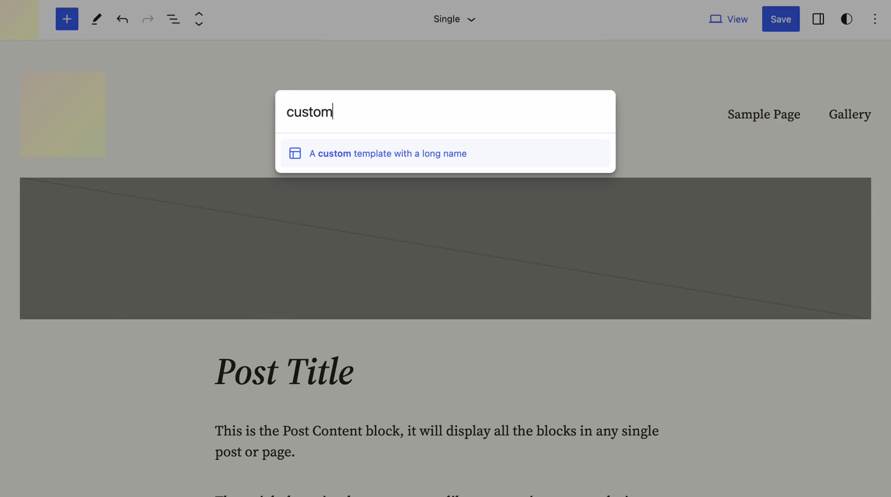
Notes:
Command Center

Slide 14
Collaboration
#WCEU2023

Slide 15
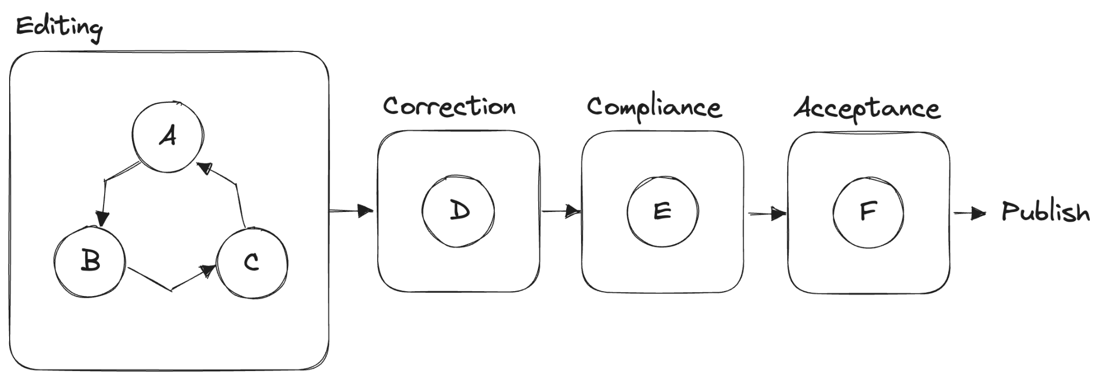
#WCEU2023

Slide 16
Real-Time Collaboration
#WCEU2023

Slide 17
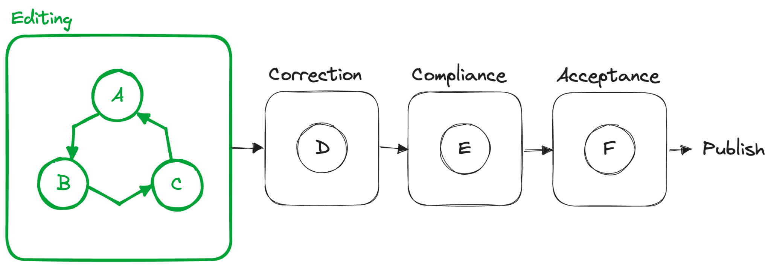
#WCEU2023

Slide 18
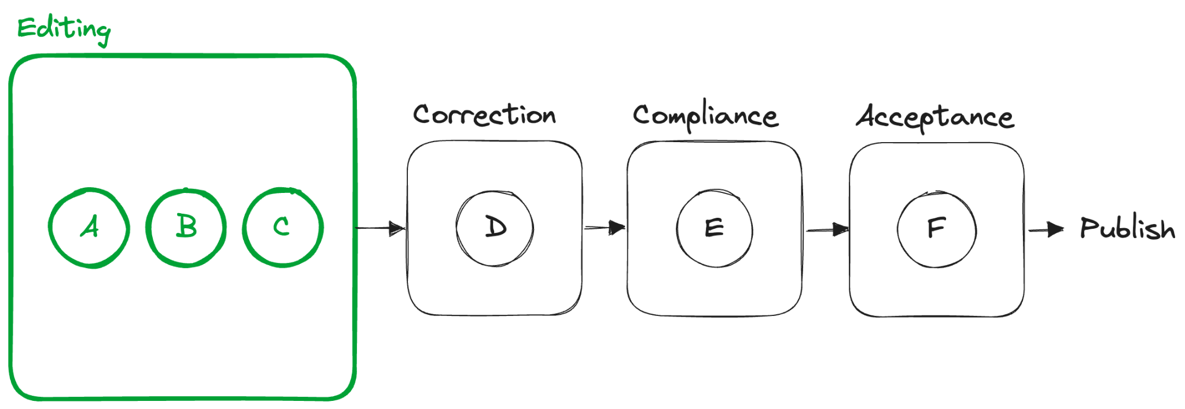
#WCEU2023

Slide 19
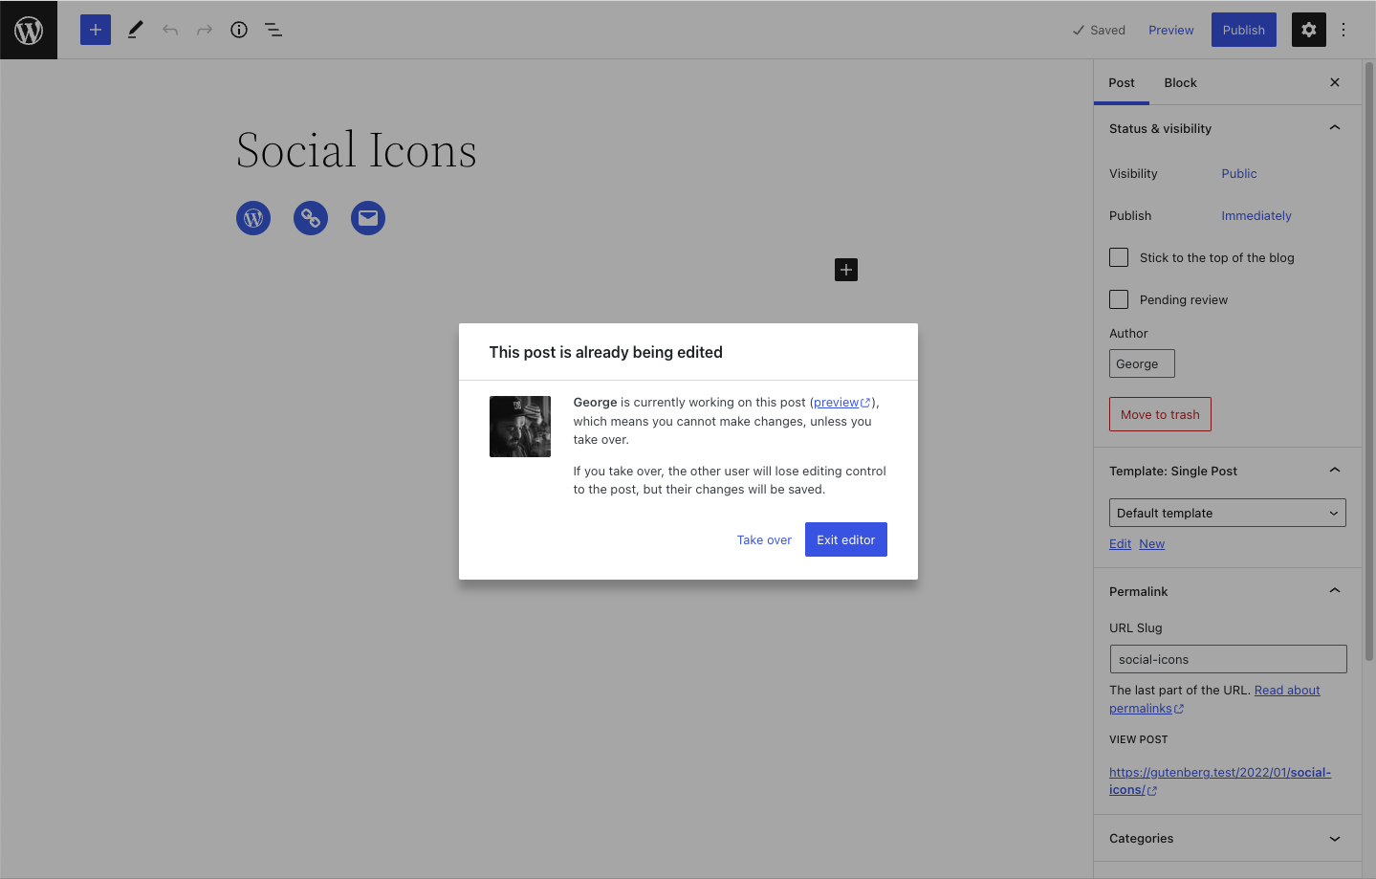

Slide 20
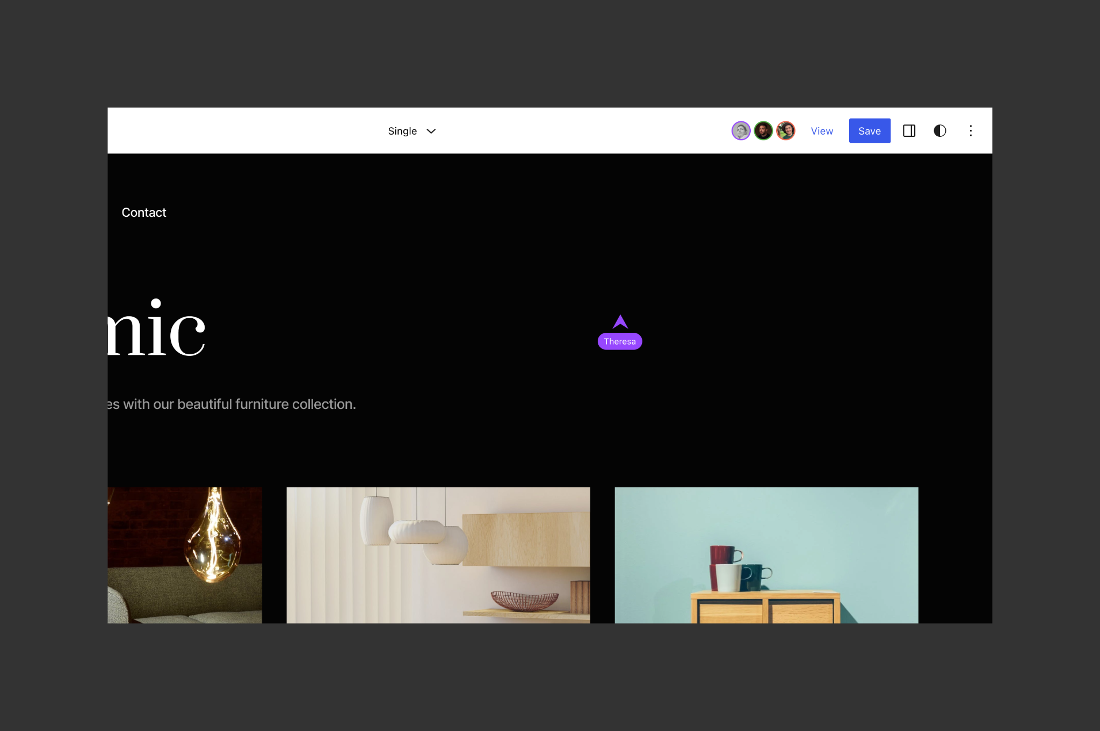

Slide 21
“There’s no real-time collaboration without collaboration”
#WCEU2023

Slide 22
Network layer agnostic
#WCEU2023

Slide 23
In ideal world it should be network layer agnostic
But usually to keep things simple you stick to one:
Short or long polling (HTTP) 👍
Websockets 💪
WebRTC 💥
#WCEU2023

Slide 24
Server or peer-to-peer?
#WCEU2023

Slide 25
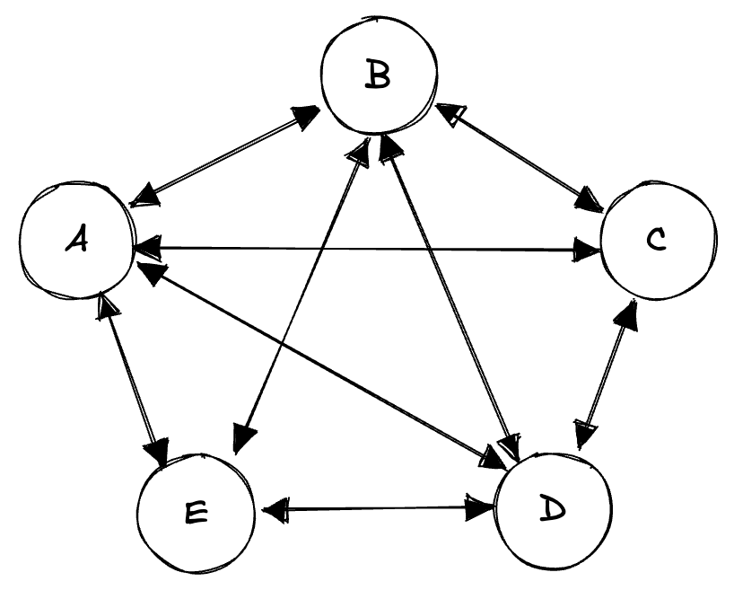
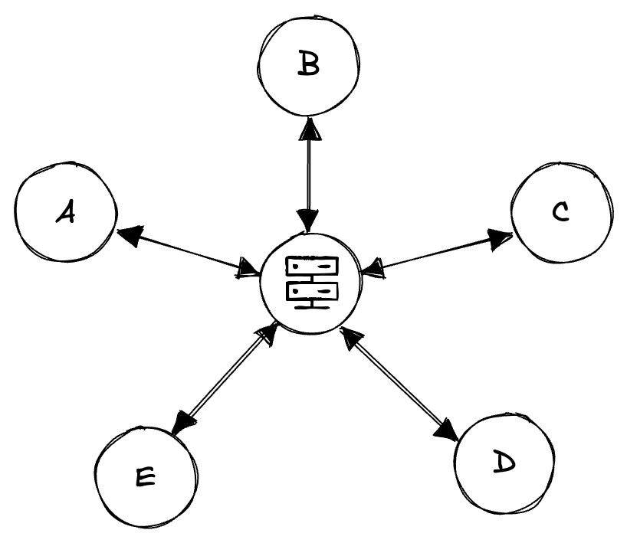
WebRTC
Websockets / HTTP
#WCEU2023

Slide 26
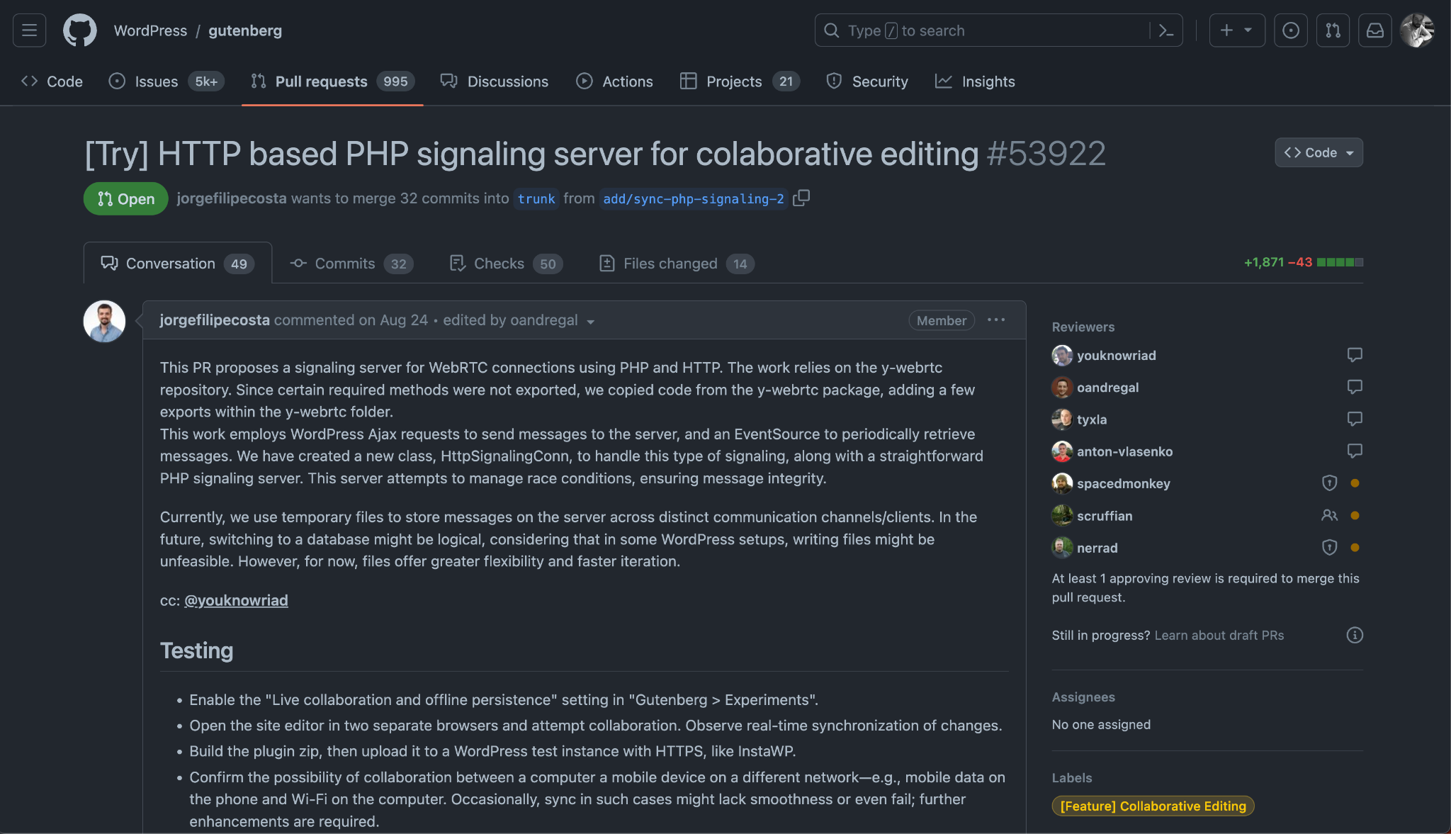

Slide 27
Concurrency
#WCEU2023

Slide 28
#WCEU2023

Slide 29
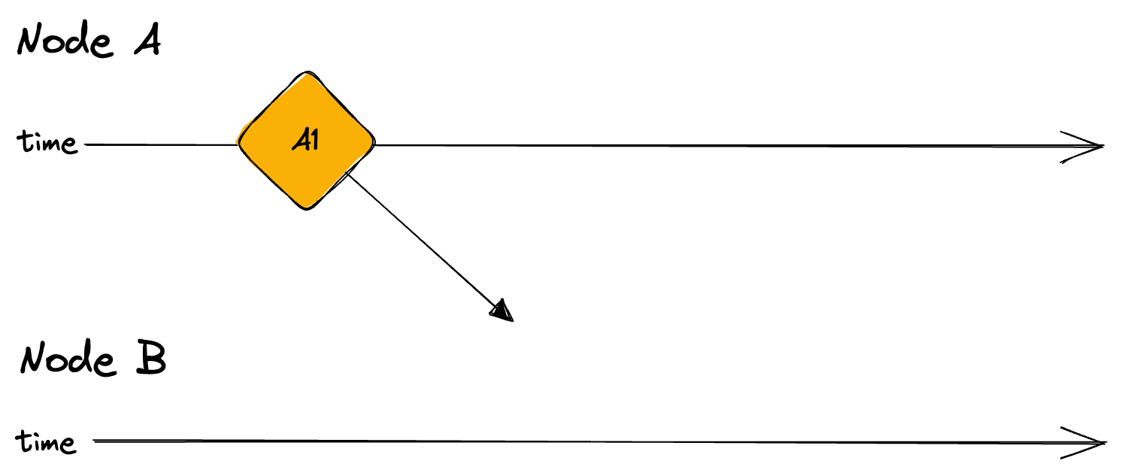
#WCEU2023

Slide 30
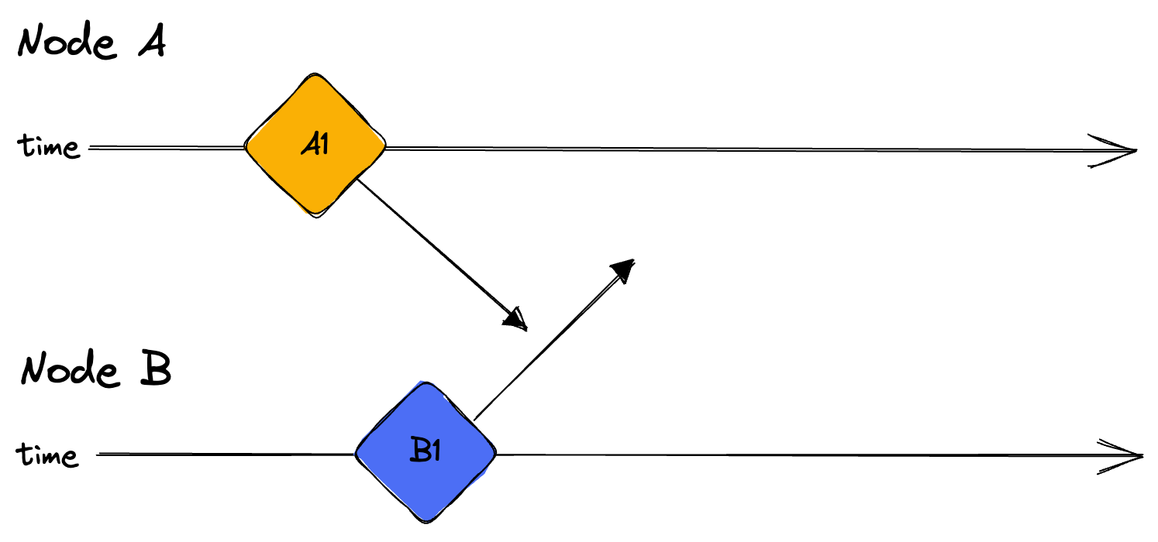
#WCEU2023

Slide 31
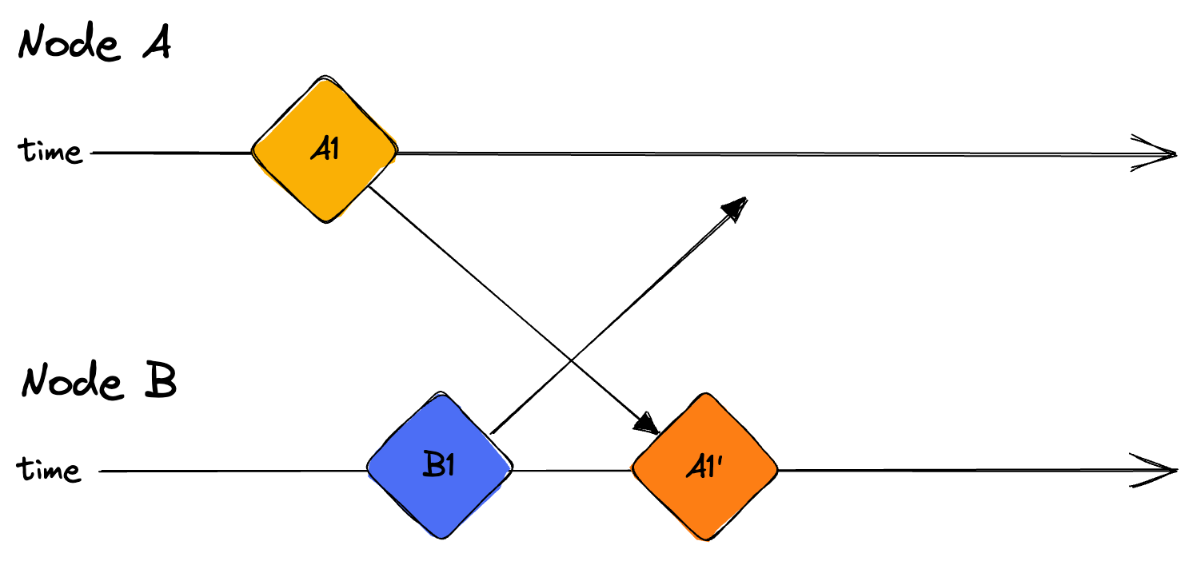
#WCEU2023

Slide 32
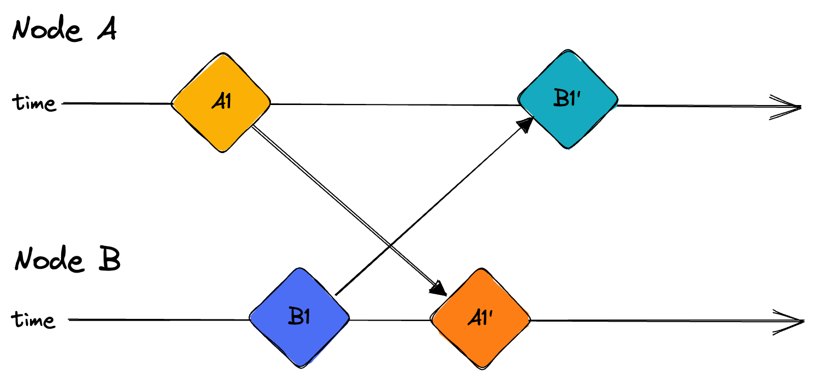
#WCEU2023

Slide 33
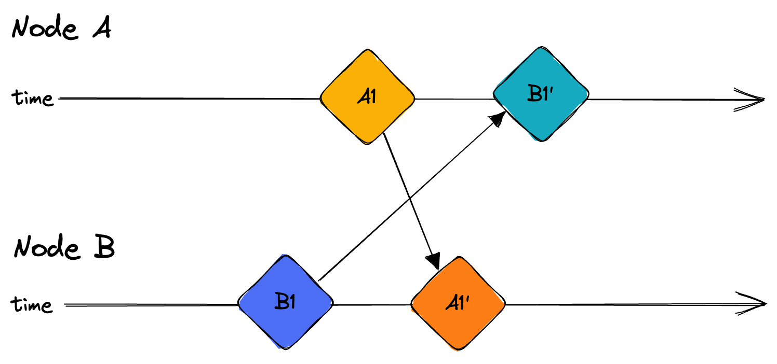
#WCEU2023

Slide 34
Just use timestamps…
Computer clock timestamps are unreliable
Physical clocks in computers are non-monotonic
Clock drift
Monotonic clocks can’t be compared between multiple machines
Distributed systems use logical clocks instead (or hybrid)
#WCEU2023

Slide 35
Avoid concurrency by using server?
#WCEU2023

Slide 36
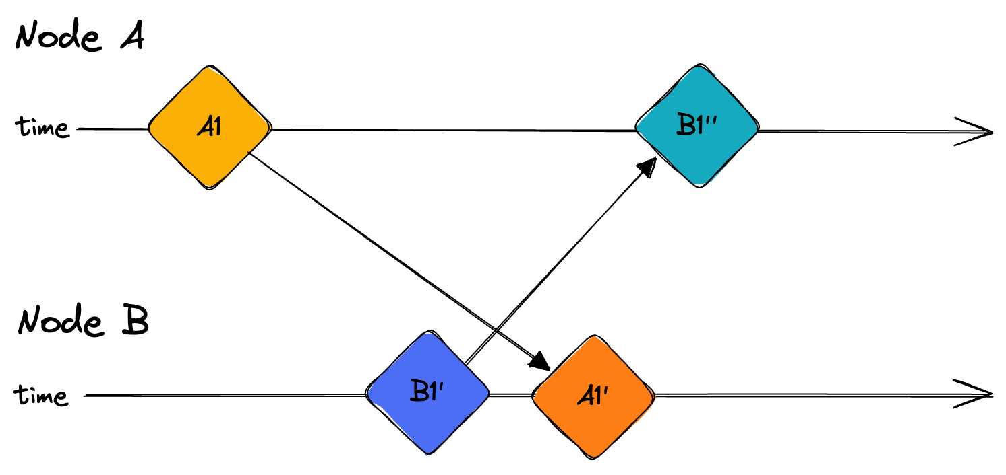
#WCEU2023

Slide 37
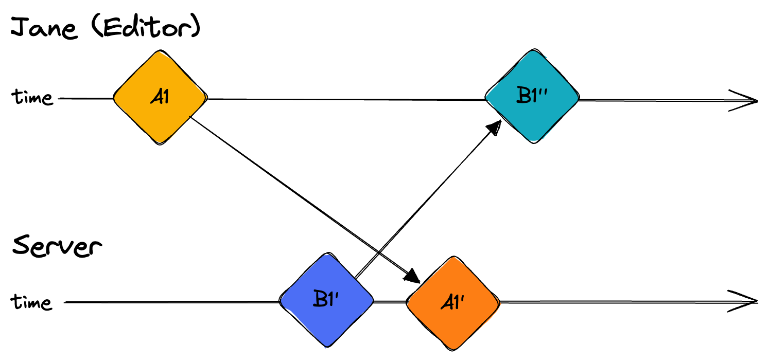
#WCEU2023

Slide 38
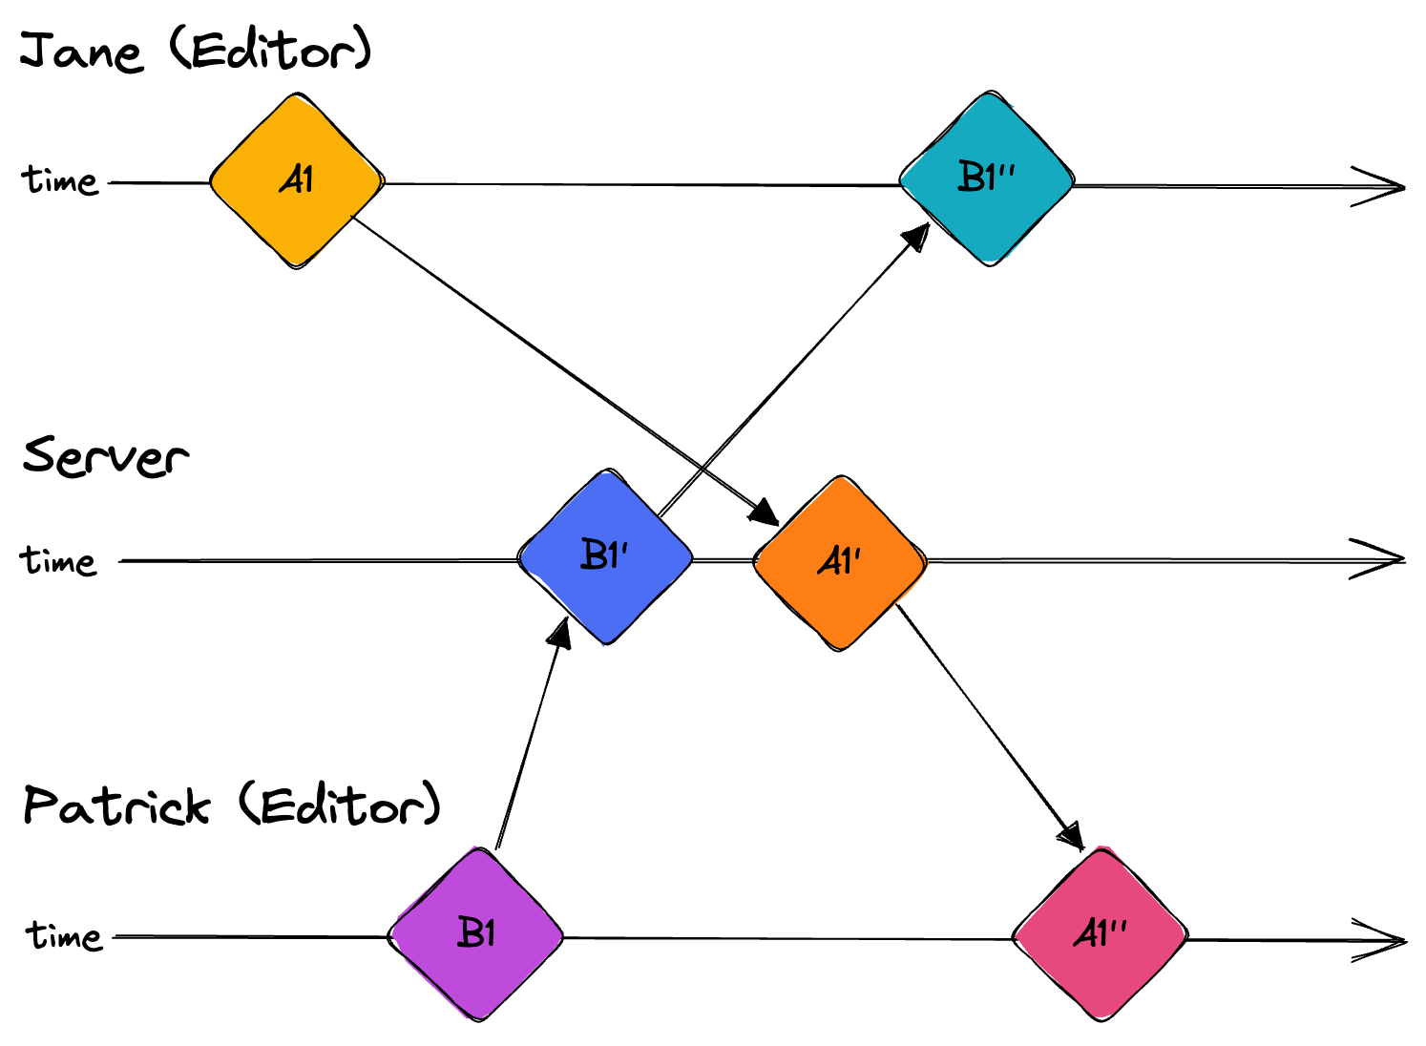
#WCEU2023

Slide 39
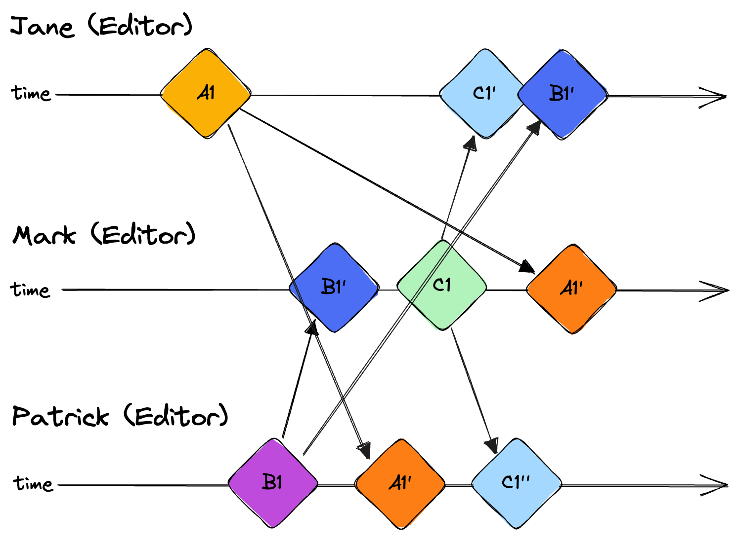
#WCEU2023

Slide 40
Handling concurrent
editing
Strong eventual consistency: everyone should see the same state
Intent preservation: The state should be reasonable
#WCEU2023

Slide 41
Solutions
#WCEU2023

Slide 42
OT
—
CRDT
#WCEU2023

Slide 43
Operational Transformation
#WCEU2023

Slide 44
#WCEU2023

Slide 45
#WCEU2023

Slide 46
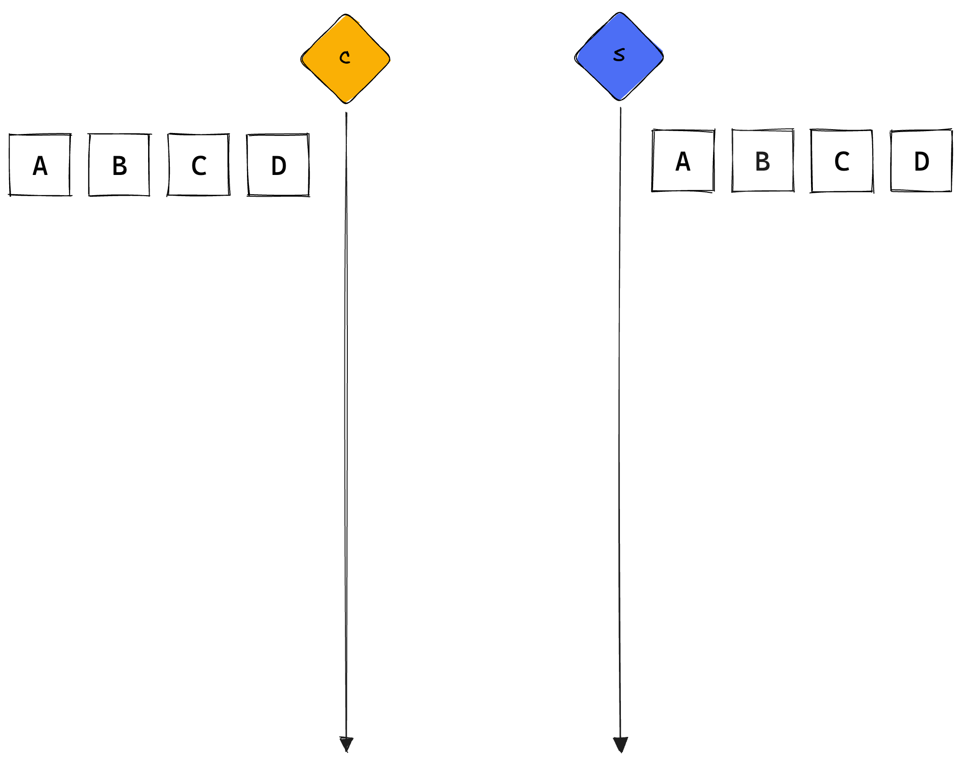
#WCEU2023

Slide 47
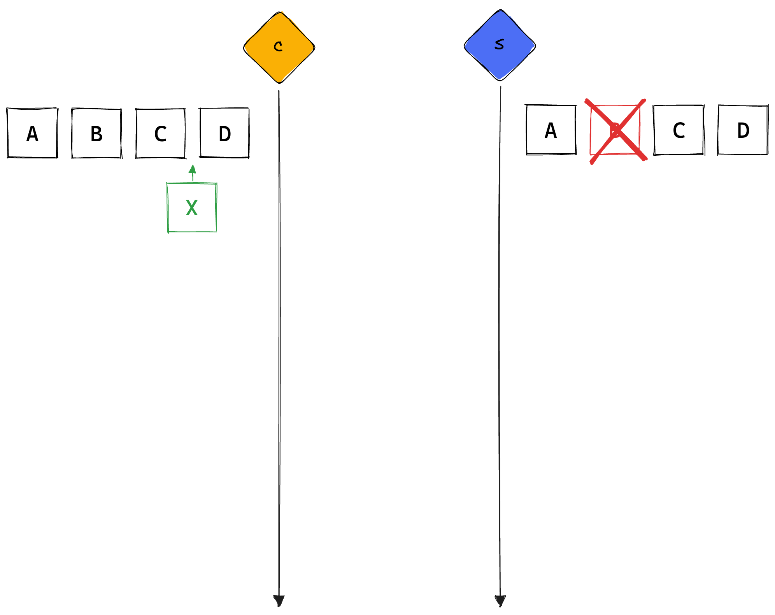
#WCEU2023

Slide 48
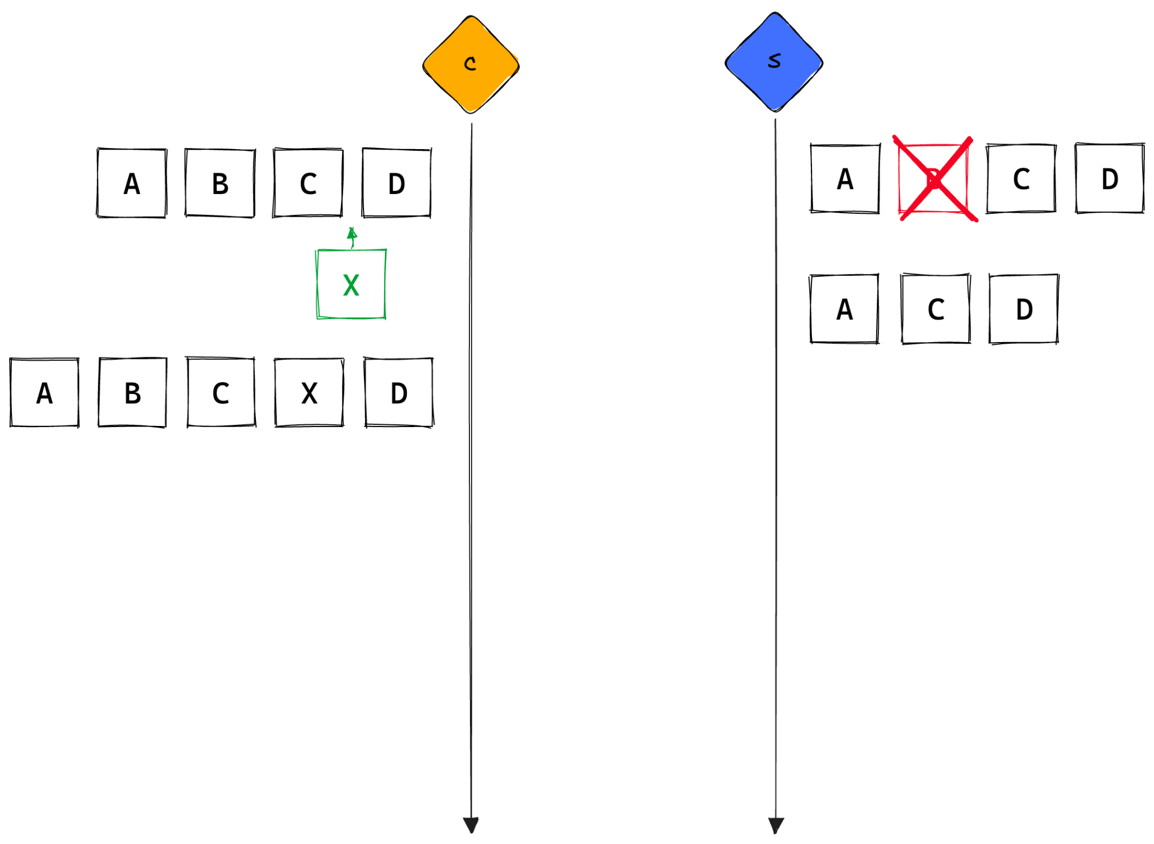
#WCEU2023

Slide 49
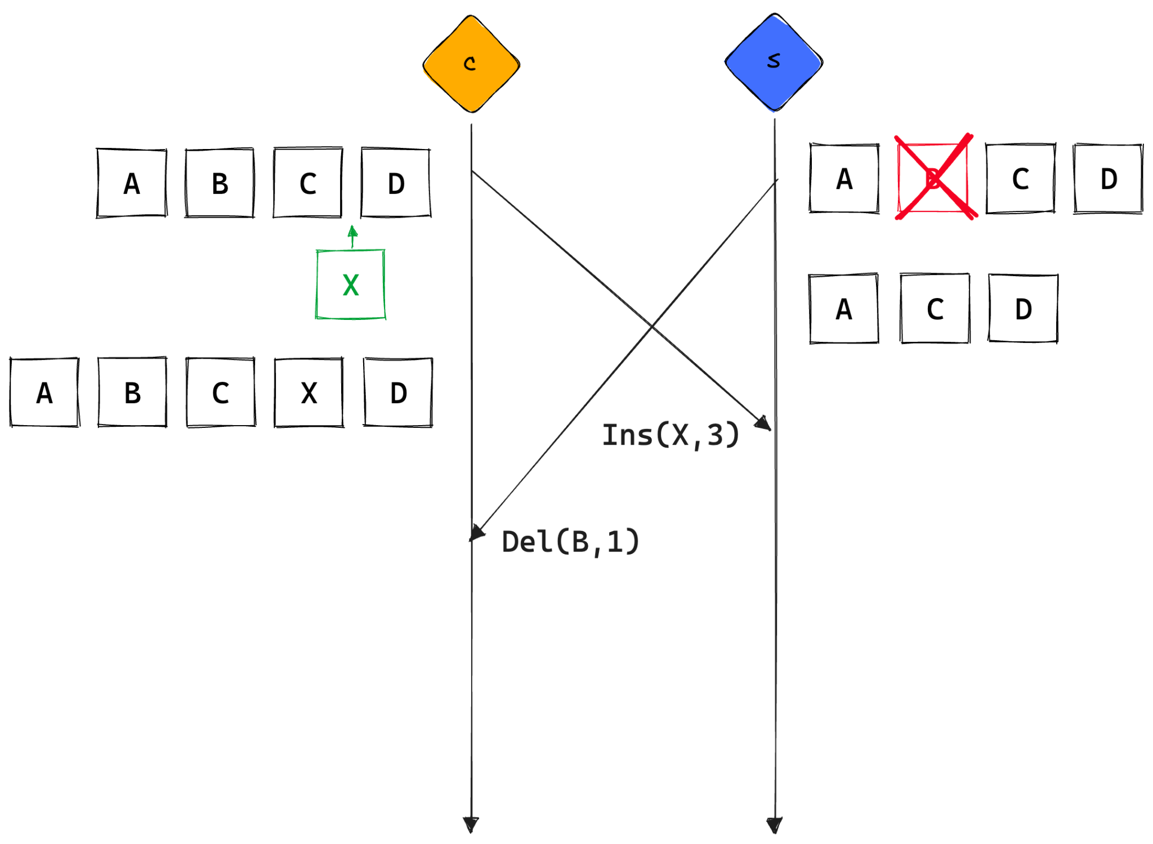
#WCEU2023

Slide 50
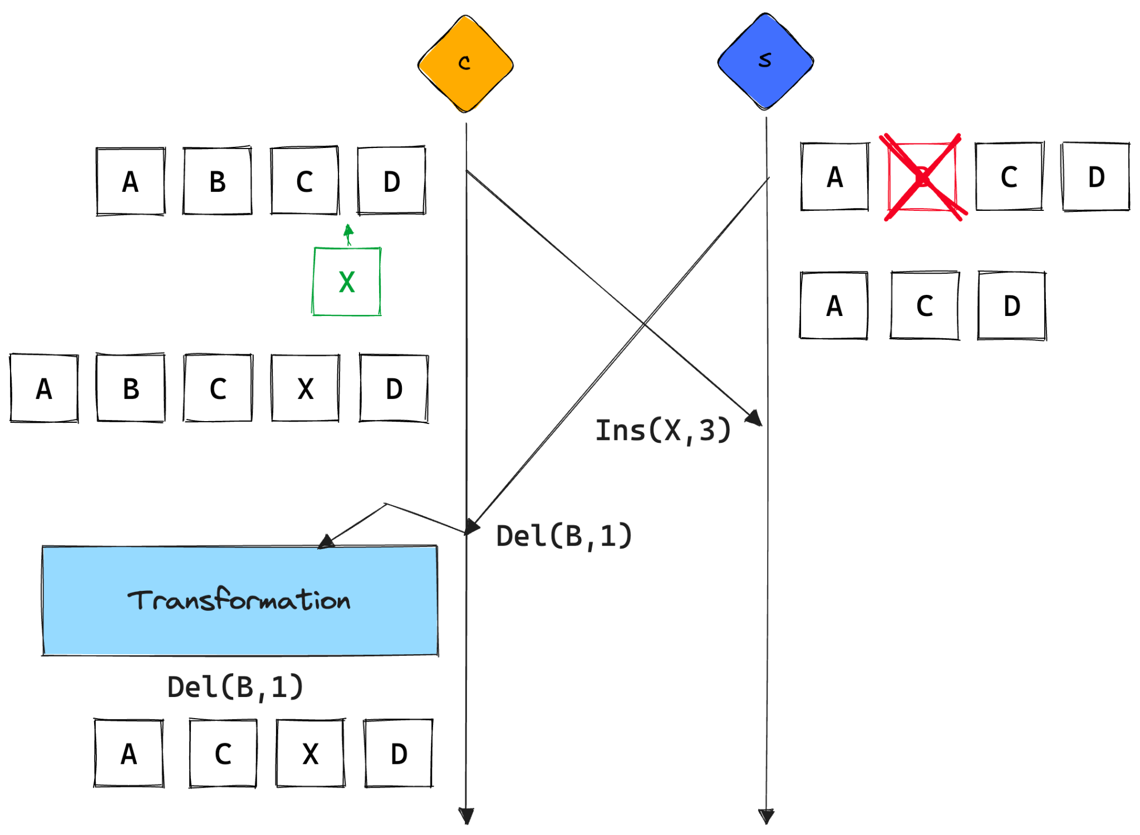
#WCEU2023

Slide 51
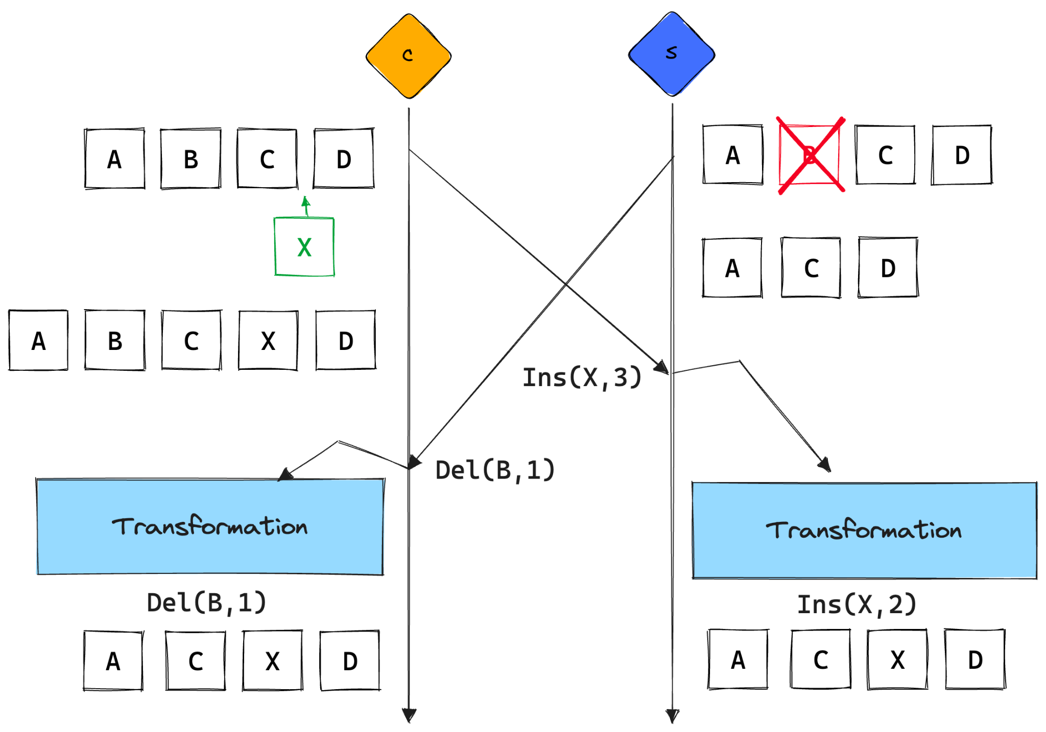
#WCEU2023

Slide 52
dOPT
Ellis & Gibbs, 1989
adOPTed
Ressel et al. 1996
Jupiter
Nichols et al. 1995
SOCT2
Suleiman et al. 1997
SOCT3/4
Vidot et al. 2000
IMDR
Imine et al. 2003
SDT
Li & Li 2004
TTF
Oster et al. 2006
Credit: Martin Kleppmann https://youtu.be/B5NULPSiOGw?t=732

Slide 53
dOPT
Ellis & Gibbs, 1989
adOPTed
Ressel et al. 1996
Jupiter
Nichols et al. 1995
SOCT2
Suleiman et al. 1997
SOCT3/4
Vidot et al. 2000
IMDR
Imine et al. 2003
SDT
Li & Li 2004
TTF
Oster et al. 2006
Credit: Martin Kleppmann https://youtu.be/B5NULPSiOGw?t=732

Slide 54
Order matters
#WCEU2023

Slide 55
What if operations are…
#WCEU2023

Slide 56
…commutative…
#WCEU2023

Slide 57
3 x 5 x 10 = 150
#WCEU2023

Slide 58
3 x 10 x 5 = 150
#WCEU2023

Slide 59
10 x 5 x 3 = 150
#WCEU2023

Slide 60
WordCamp
#WCEU2023

Slide 61
WordCamp
Hello WordCamp
WordCamp rules!
#WCEU2023

Slide 62
WordCamp
Hello WordCamp
WordCamp rules!
ins(“Hello “, 0)
ins(“ rules!“, 8)
#WCEU2023

Slide 63
WordCamp
Hello WordCamp
WordCamp rules!
ins(“Hello “, 0)
ins(“ rules!“, 8)
#WCEU2023

Slide 64
WordCamp
0
Hello WordCamp
WordCamp rules!
ins(“Hello “, 0)
ins(“ rules!“, 8)
#WCEU2023

Slide 65
WordCamp
Hello WordCamp
WordCamp rules!
ins(“Hello “, 0)
ins(“ rules!“, 8)
Hello WordCamp rules!
#WCEU2023

Slide 66
WordCamp
Hello WordCamp
WordCamp rules!
ins(“Hello “, 0)
ins(“ rules!“, 8)
Hello WordCamp rules!
#WCEU2023

Slide 67
WordCamp
8
Hello WordCamp
WordCamp rules!
ins(“Hello “, 0)
ins(“ rules!“, 8)
Hello WordCamp rules!
#WCEU2023

Slide 68
WordCamp
Hello WordCamp
WordCamp rules!
ins(“Hello “, 0)
ins(“ rules!“, 8)
Hello Worules!rdCamp
Hello WordCamp rules!
#WCEU2023

Slide 69
WordCamp
Hello WordCamp
WordCamp rules!
ins(“Hello “, 0)
ins(“ rules!“, 8)
Hello Worules!rdCamp
Hello WordCamp rules!
ins(“Hello “, 0)
,
ins(“ rules!“, 8)
≠
ins(“ rules!“, 8)
,
ins(“Hello “, 0)
#WCEU2023

Slide 70
#WCEU2023

Slide 71
…and idempotent
#WCEU2023

Slide 72
5 x 1 = 5
#WCEU2023

Slide 73
5 x 1 x 1 = 5
#WCEU2023

Slide 74
5 x 1 x 1 x 1 = 5
#WCEU2023

Slide 75
5 x 1 x 1 x 1 x 1 = 5
#WCEU2023

Slide 76
5 x 1 x 1 x 1 x 1 x … = 5
#WCEU2023

Slide 77
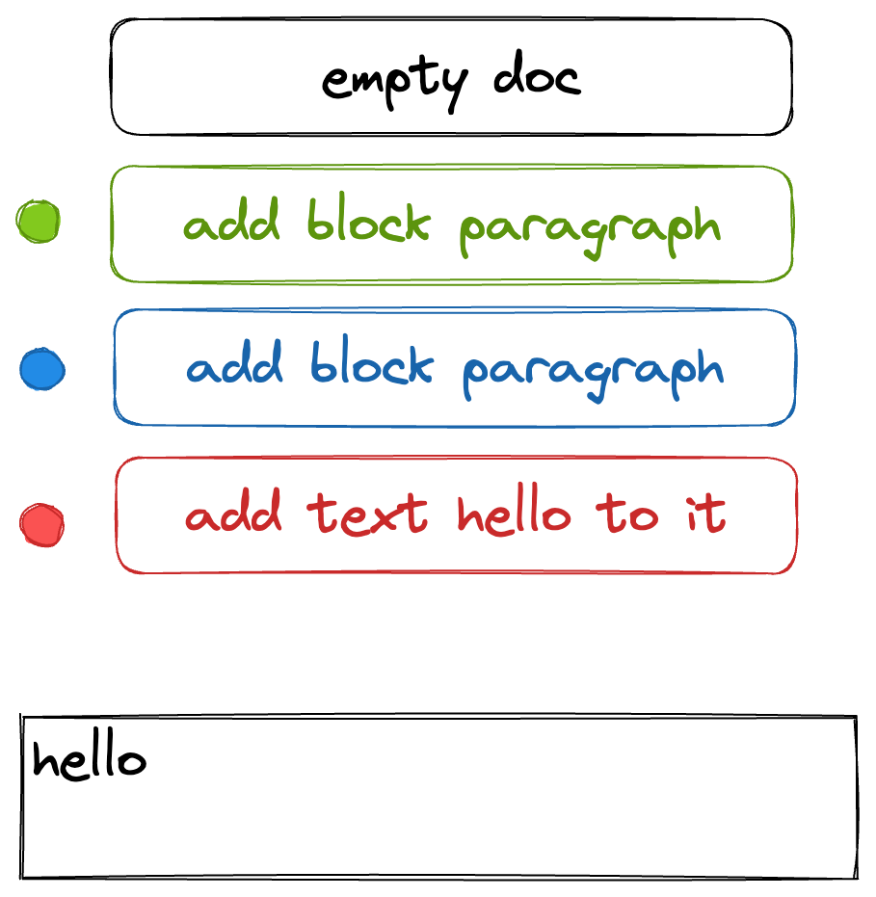
#WCEU2023

Slide 78
Commutative
+
Idempotent
#WCEU2023

Slide 79
Commutative
+
Idempotent
=
Synchronization
#WCEU2023

Slide 80
CRDT
Conflict-Free Replicated Data Types
#WCEU2023

Slide 81
Main advantages
Offline editing (local-first apps)
Changes merging
Supports operation-based and state-based syncs
No need for server (but can be added)
#WCEU2023

Slide 82
WOOT
Oster, Urso, Molli, Imine. 2006
Treedoc
Preguiça, Marquès, Shapiro, Leția. 2009
Logoot
Weiss, Urso, Molli 2009/2010
RGA
Roh, Jeon, Kim, Lee. 2011
LSEQ
Nédelec, Molli, Mostefaoui, Desmontils. 2013
Astrong
Attiya, Burckhardt, Gotsman, Morrison, Yang, Zawirski. 2016

Slide 83
#WCEU2023

Slide 84
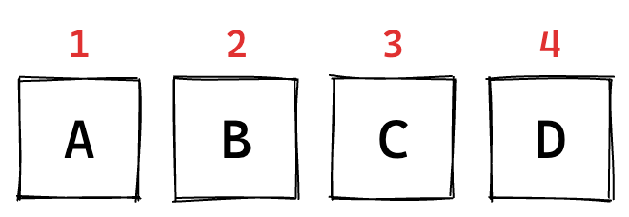
#WCEU2023

Slide 85
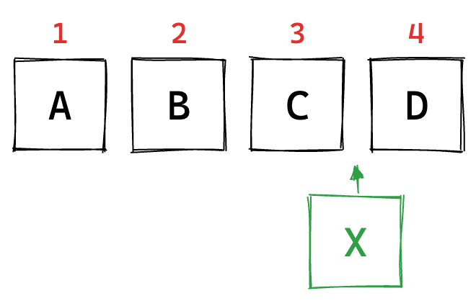
#WCEU2023

Slide 86
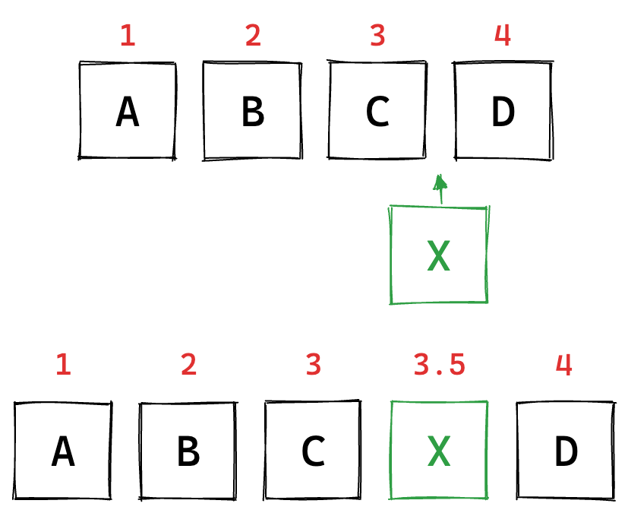
#WCEU2023

Slide 87
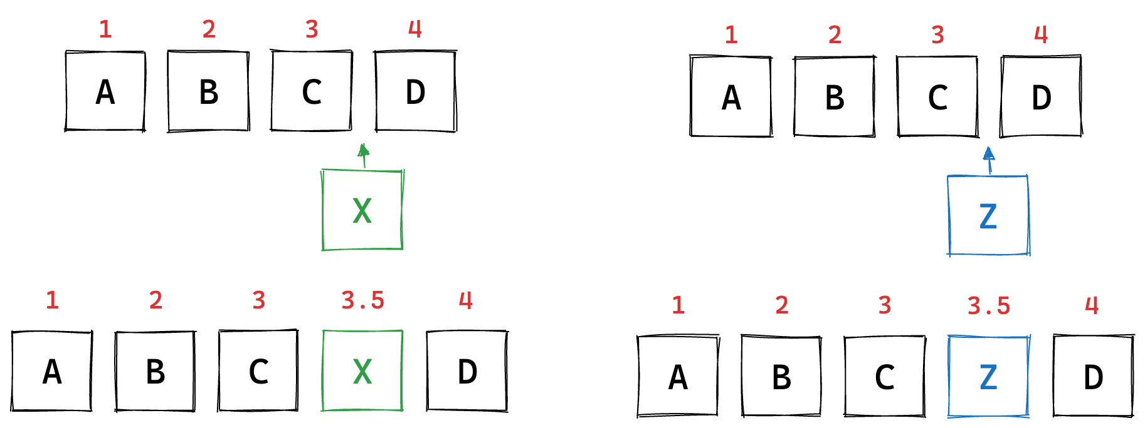
#WCEU2023

Slide 88
#WCEU2023

Slide 89
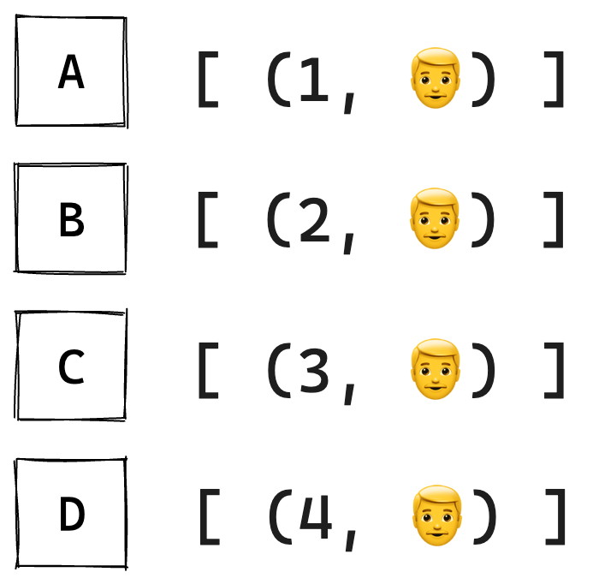
#WCEU2023

Slide 90
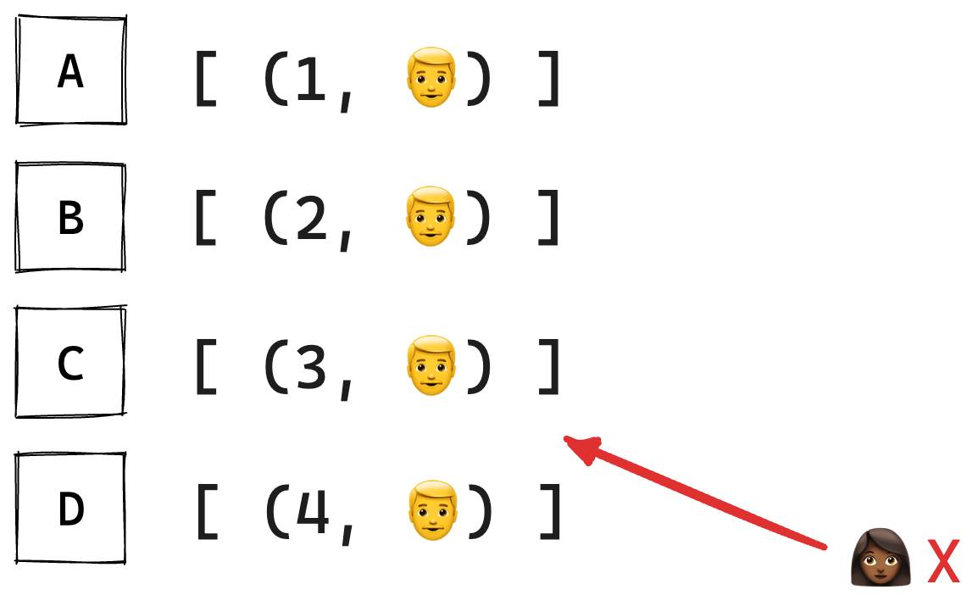
#WCEU2023

Slide 91
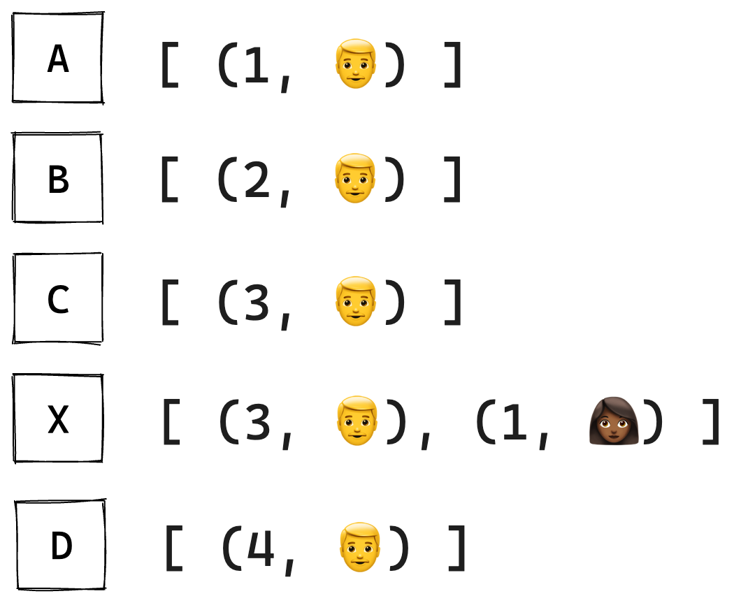
#WCEU2023

Slide 92
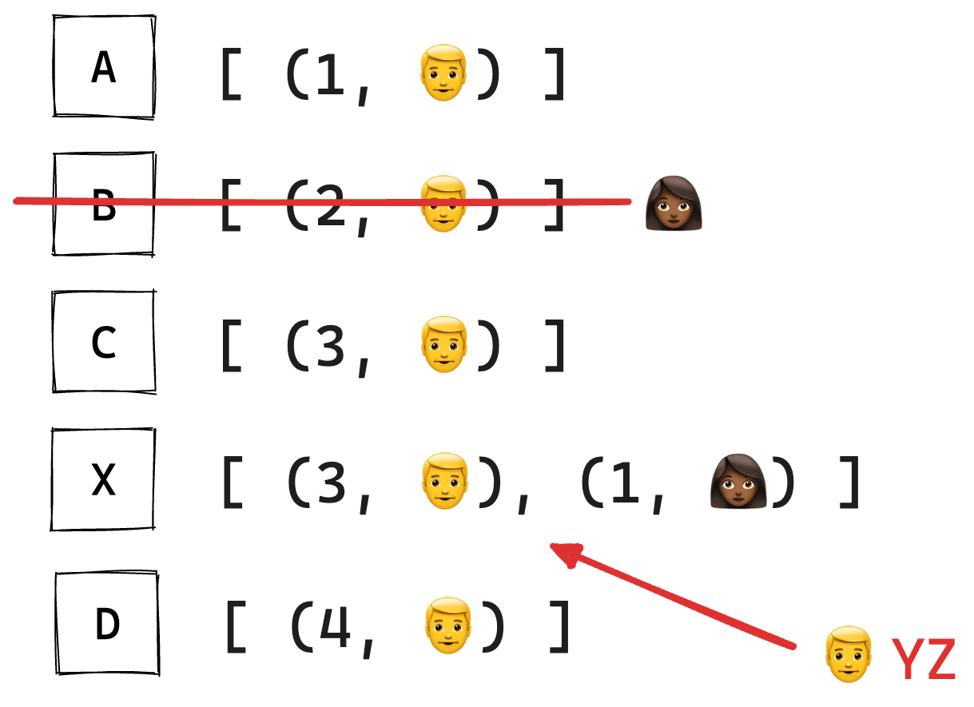
#WCEU2023

Slide 93
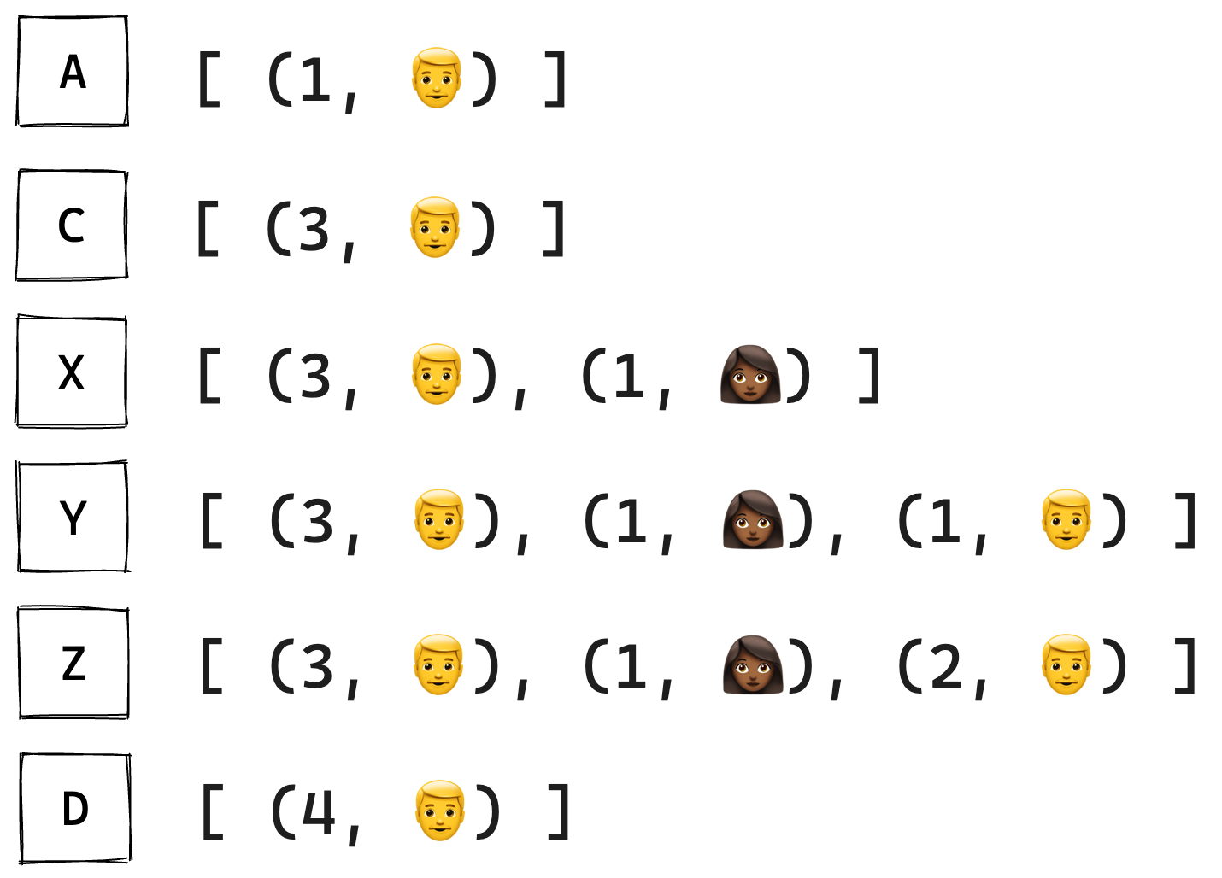
#WCEU2023

Slide 94
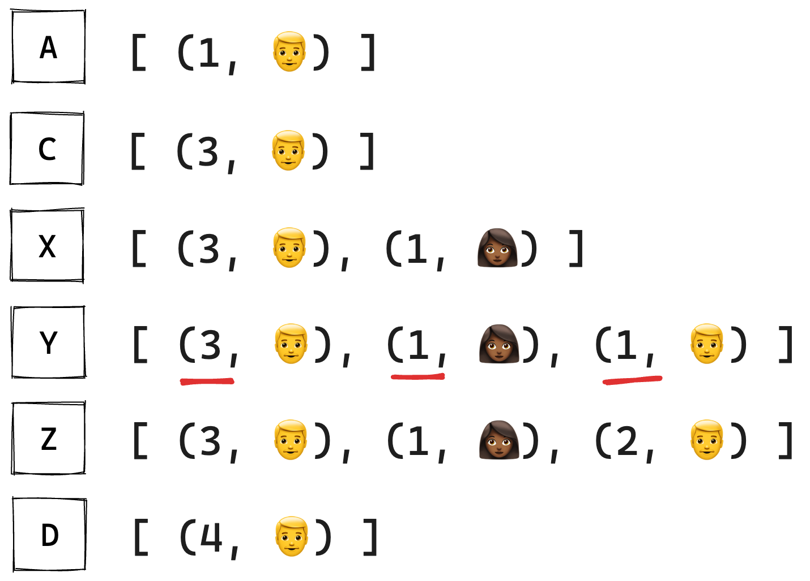
#WCEU2023

Slide 95
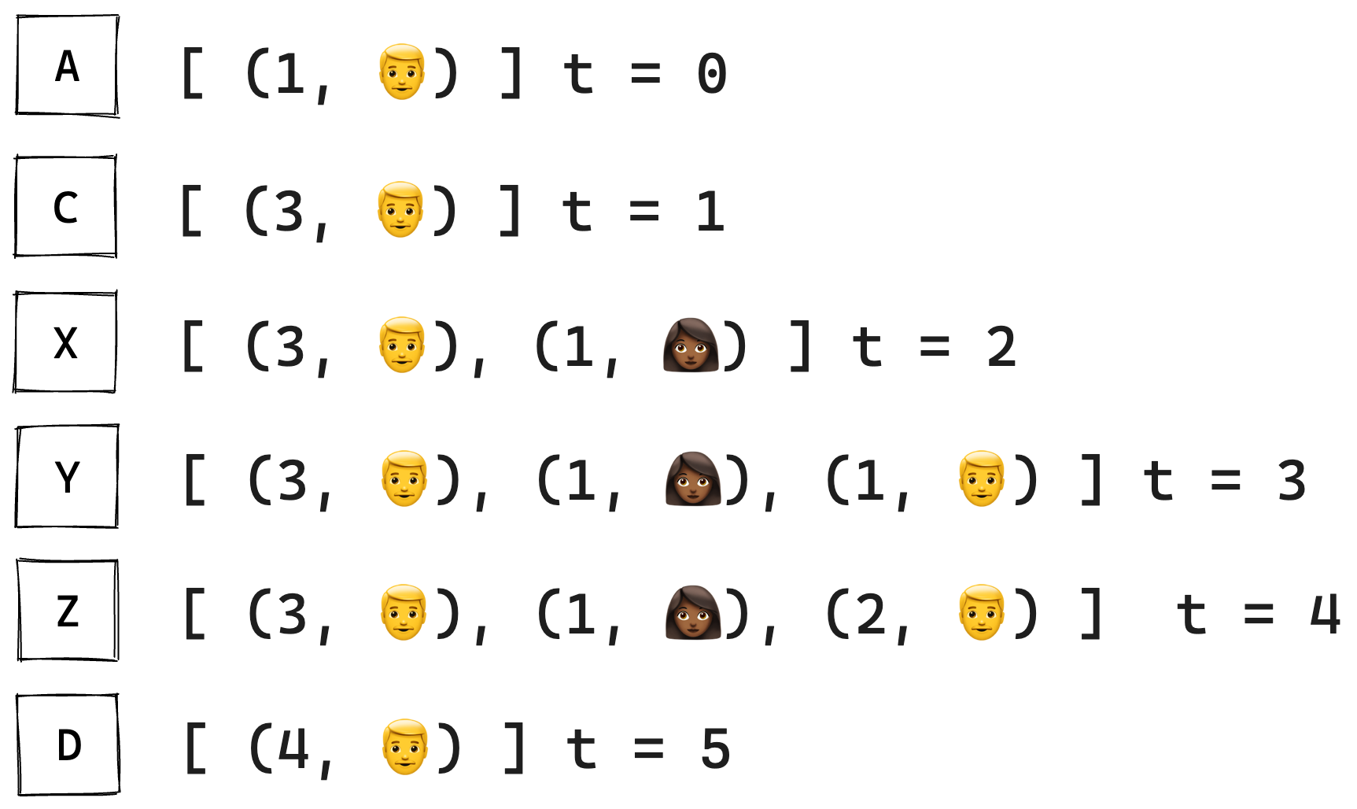
#WCEU2023

Slide 96
#WCEU2023

Slide 97
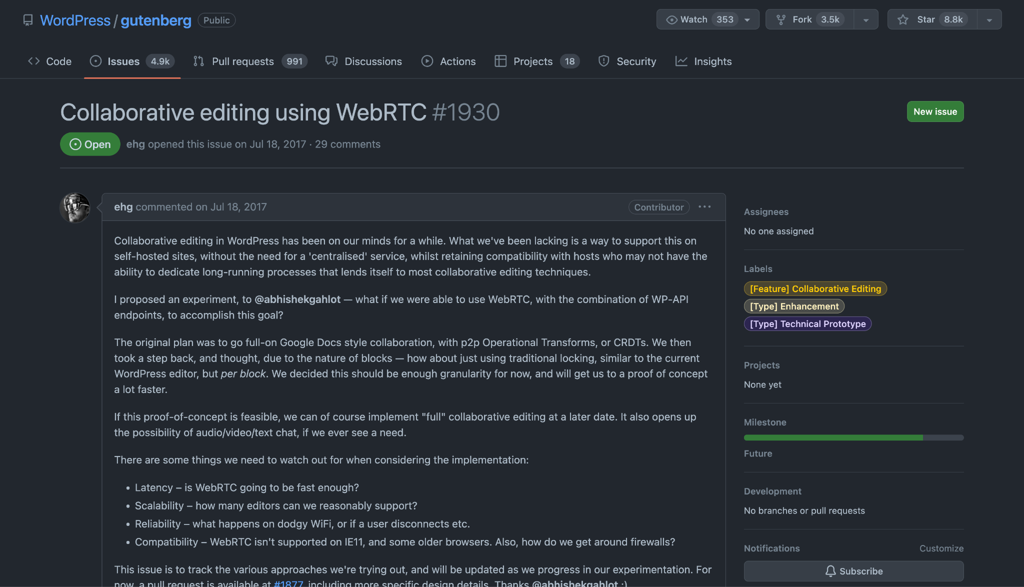
Notes:
Chris Blower (Automattic)

Slide 98
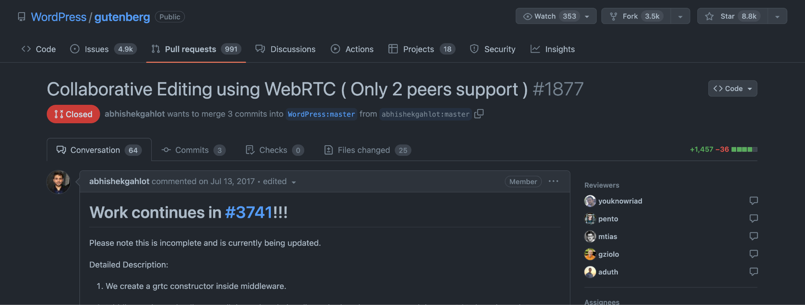
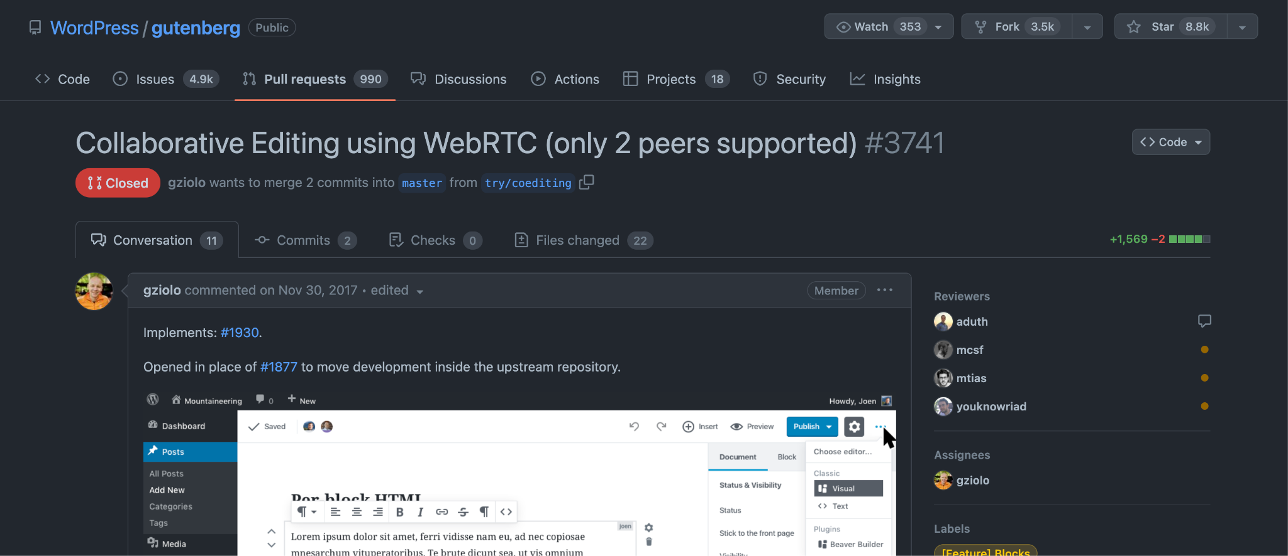
Notes:
Abhishek Gahlot (back then Automattic)
Grzegorz Ziółkowski (Automattic)

Slide 99
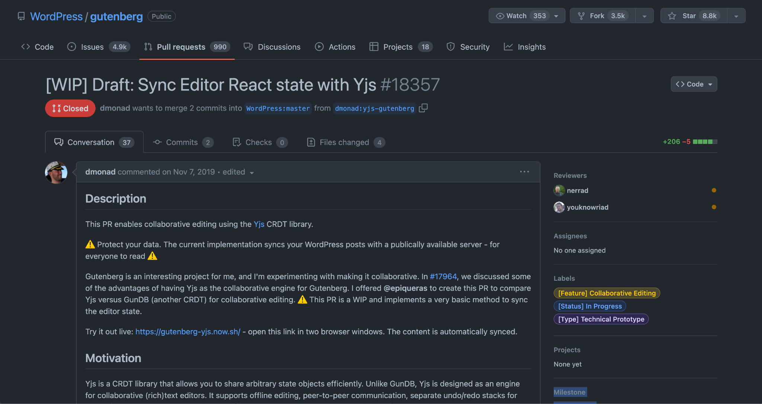
Notes:
Kevin Jahns from YJS

Slide 100
gutenberg-yjs.vercel.app
Notes:
Kevin Jahns from YJS

Slide 101
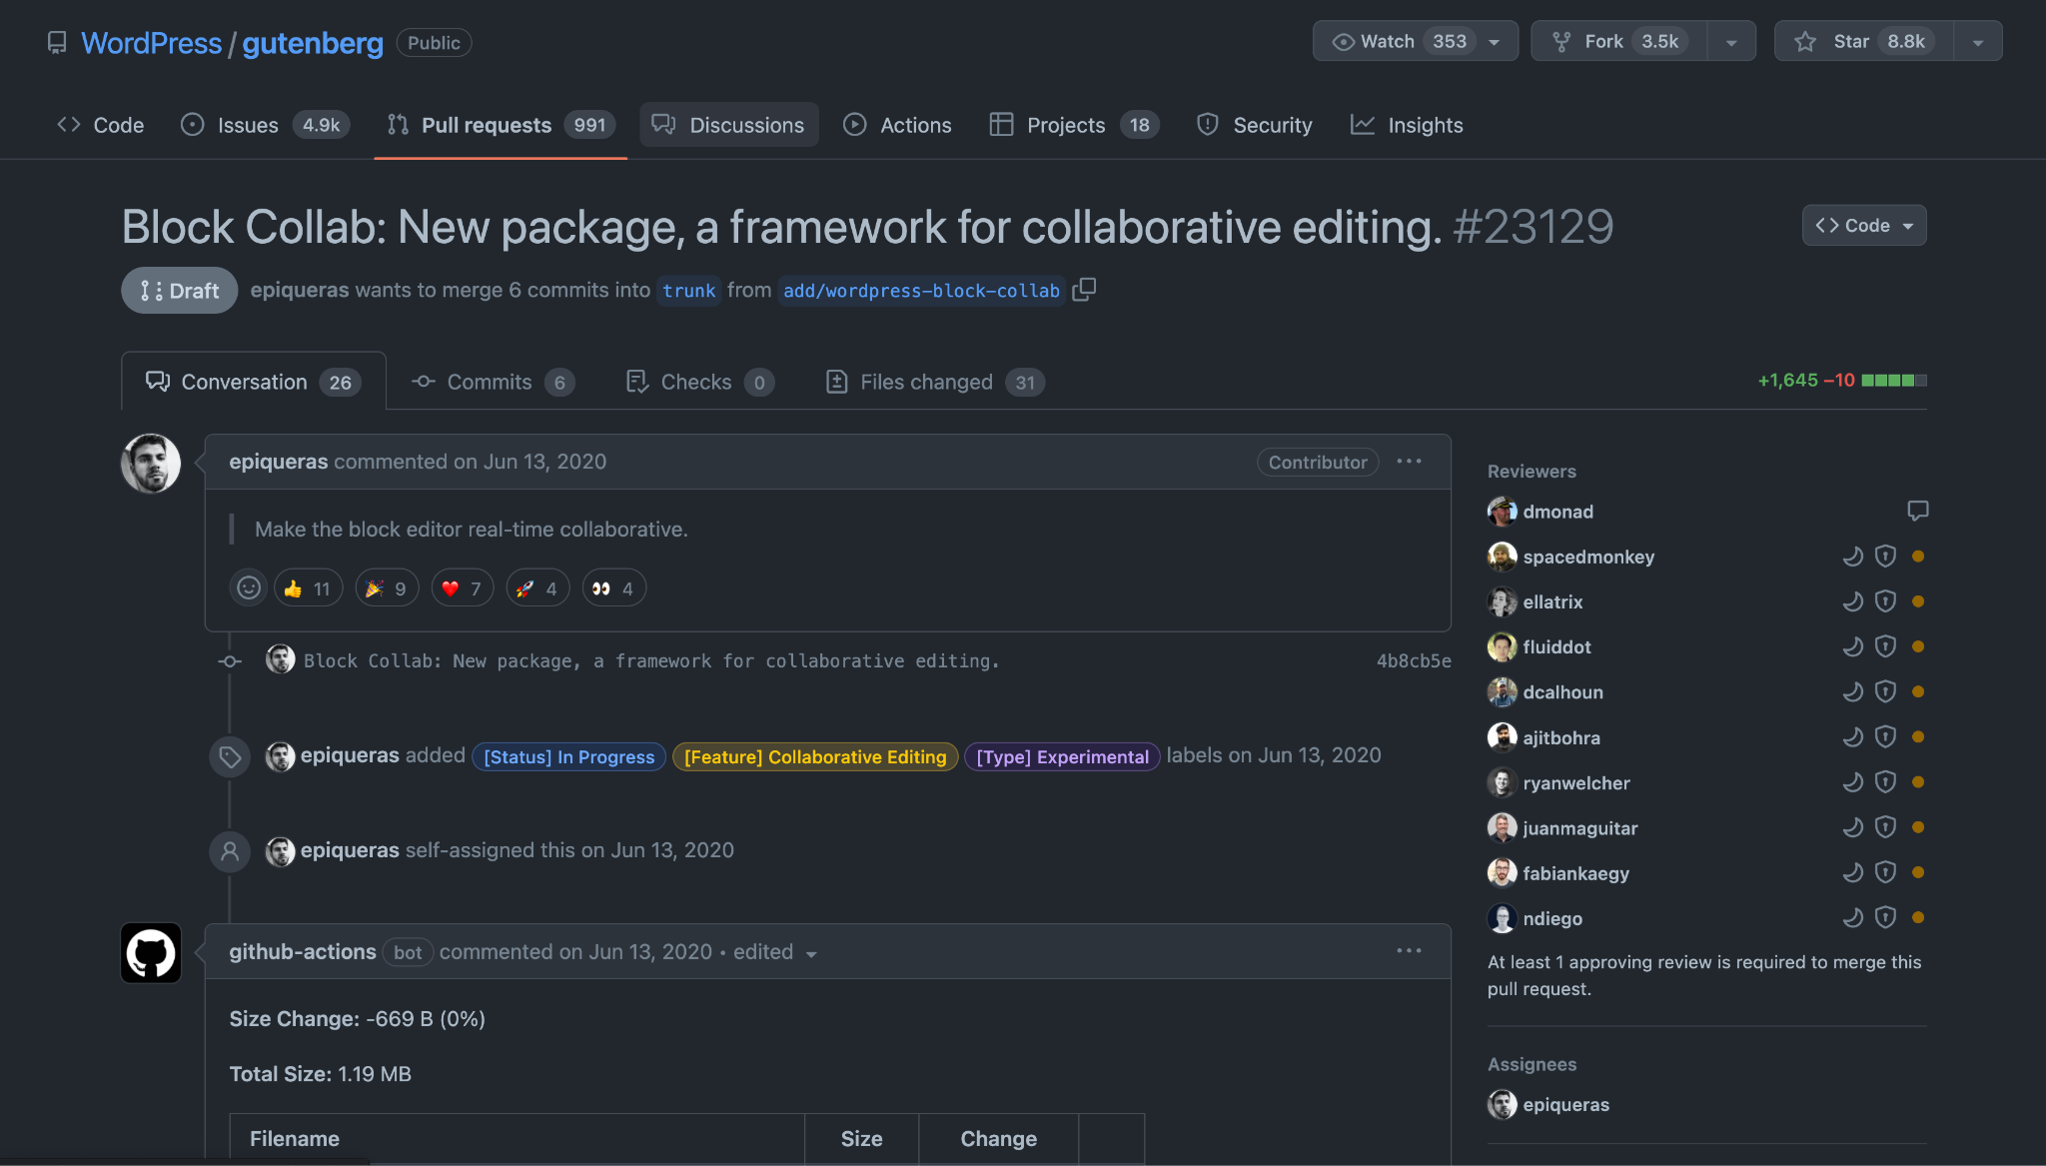
Notes:
Enrique Piqueras (back then at Automattic, now at Google)

Slide 103
asblocks.com
#WCEU2023
Notes:
Riad Benguella (Automattic)

Slide 104
#WCEU2023

Slide 106
Thank you!
#WCEU2023

